Slide 1

Emergency Preparedness Regulations in the Rural Healthcare Facilities
By Jeff Harper
Principal with InQuiseek
November 6, 2018
Georgia Rural Health Association

Slide 2
Lessons Learned in 2005 in Louisiana
In 2005, only 25% of office-based providers were using electronic medical records. Dorothy Jones, RHIT, health information supervisor at Medical Center of Louisiana in New Orleans, thought removing the bottom rows of records in her hospital’s basement storage facility would be enough to guard against Hurricane Katrina’s punch August 29, 2005.In a matter of hours, 400,000 medical records were reduced to pulp.

Slide 3
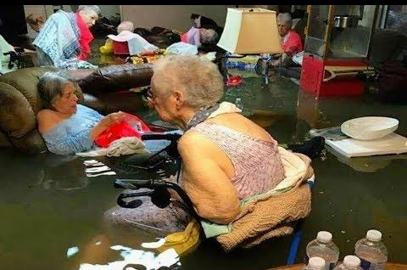
Lessons Learned in 2005 with Rita in Louisiana
In 2005, when Rita hit flooding happened so fast with no plan of communication that nursing homes had waist high water with residents stranded.

Slide 4
Lessons Learned in 2016 with record flooding in Louisiana
In August 2016. the Cajun Navy was introduced because no one else was prepared to handle rainfall that was 3 times the amount of Katrina that created a flash flood of record proportions.

Slide 5
Last Week on Thursday nite in Louisiana
Birmingham 5:45 11/1/2018 --
At least 11 tornadoes have been confirmed by National Weather Service surveyors so far in Louisiana and Mississippi as part of a storm system that moved across the region Wednesday night and Thursday.
Damage surveys are planned to continue Friday in both states.
In Louisiana, the strongest storms were a pair of twisters with top winds of 115 mph (185 kph) that hit Washington Parish, north of New Orleans. Near Bogalusa, a mobile home rolled over, injuring two occupants. Both were rated EF-2 on the Enhanced Fujita scale. Two weaker tornadoes were also confirmed in and around Lake Charles, including one that damaged a vacant shopping center near McNeese State University.

Slide 6
RHC Emergency Preparedness (EP)
Proposed by CMS in 2013, new regulations would provide consistent EP requirements, enhance patient safety during emergencies for persons served by Medicare- and Medicaid-participating facilities, and establish a more coordinated and defined response to natural and man-made disasters.

Slide 7
Understanding the EP Rule
EP Requirements for Medicare and Medicaid Participating Providers/Suppliers
Published September 16, 2016
Applies to all 17 provider/supplier types
Compliance required for participation in Medicare
Implementation Date November 16, 2017

Slide 8
EP Interpretive Guidelines???
“The Interpretive Guidelines are sub regulatory guidelines, not laws, which establish our expectations for the function states perform in enforcing the regulatory requirements. Facilities do not require the IGs in order to implement the regulatory requirements.
This EP rule is accompanied by extensive resources that providers and suppliers can use to establish their emergency preparedness programs.”
Federal Register /Vol. 81, No. 180 / Friday, September 16, 2016 /Rules and Regulations 63873

Slide 9
Emergency Preparedness
Emergency preparedness. 491.12
The Rural Health Clinic/Federally Qualified Health Center (RHC/FQHC) must comply with all applicable Federal, State, and local emergency preparedness requirements. The RHC/FQHC must establish and maintain an emergency preparedness program that meets the requirements of this section. The emergency preparedness program must include, but not be limited to, the following elements:

Slide 10
Emergency Preparedness
Emergency Preparedness Program
Risk Assessment and Planning
Policies and Procedures
Communication Plan
Training and Testing

Slide 11
Risk Assessment and Planning
(a) Emergency plan. The RHC/FQHC must develop and maintain an emergency preparedness plan that must be reviewed and updated at least annually. The plan must do all of the following:
(1) Be based on and include a documented, facility-based and community-based risk assessment, utilizing an all-hazards approach.
(2) Include strategies for addressing emergency events identified by the risk assessment.
(3) Address patient population, including, but not limited to, the type of services the RHC/FQHC has the ability to provide in an emergency; and continuity of operations, including delegations of authority and succession plans.

Slide 12
Risk Assessment and Planning
(4) Include a process for cooperation and collaboration with local, tribal, regional, State, and Federal emergency preparedness officials' efforts to maintain an integrated response during a disaster or emergency situation, including documentation of the RHC/FQHC's efforts to contact such officials and, when applicable, of its participation in collaborative and cooperative planning efforts.

Slide 13
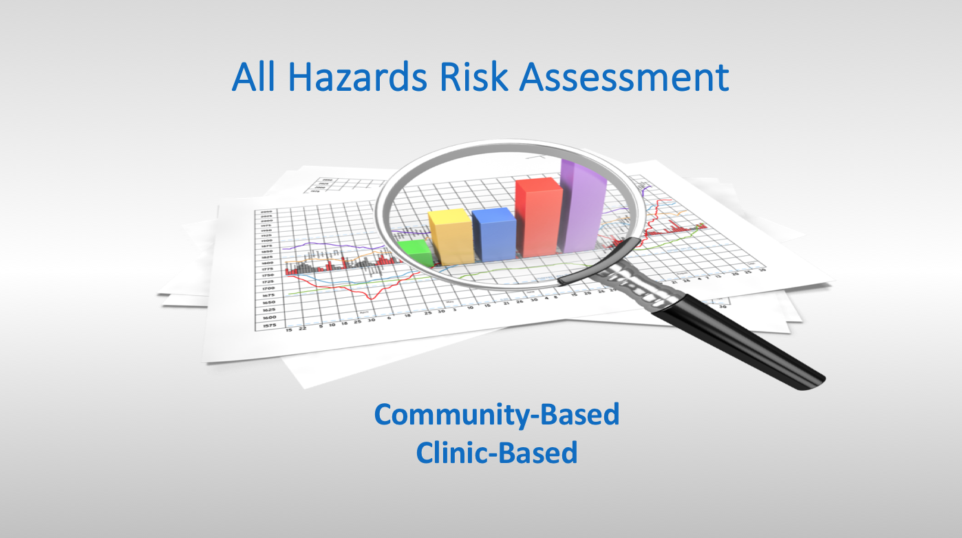
Risk Assessment and Planning

Slide 14
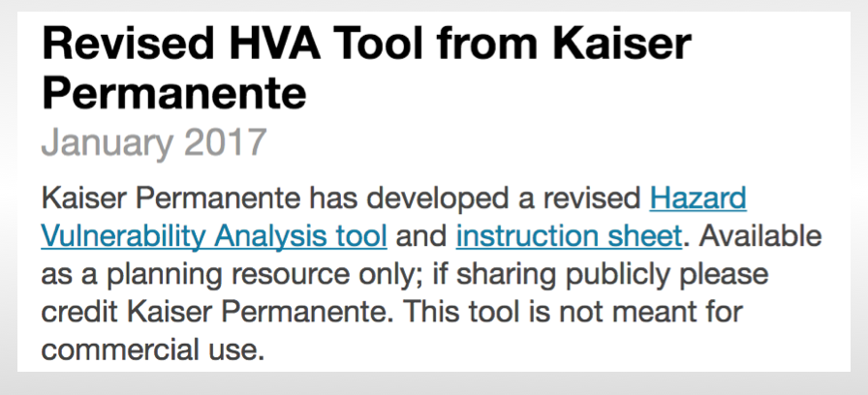

Slide 15
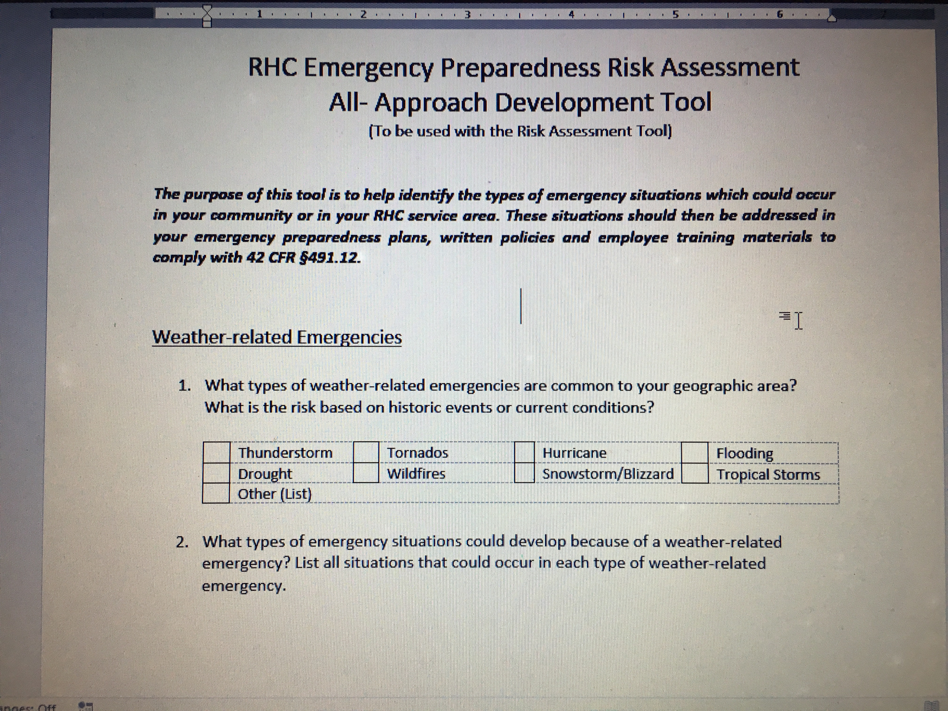
Or a simplistic one

Slide 16
Risk Assessment and Planning
Clinic-Based Hazards Assessment
What top five events are most likely to impact
the services your organization delivers to patients?
Short-term Inclement Weather Events
Power or Water Interruptions
Provider/Staff Illness
Technological/Communication Failures
On-site Events Requiring Evacuation (Fire, Threat)

Slide 17
Risk Assessment and Planning
Types of Emergencies:
Man Made: Active shooter Chemical Emergencies
Cyber Attack Mass Casualties
Bioterrorism Radiation
Natural Disasters:
Tornadoes
Hurricanes
Severe Storms
Public Health Emergencies:
Pandemic Influenza
Zika Virus Outbreak
Biological Hazards

Slide 18
Risk Assessment and Planning
Interpretive Guidelines:
EP program must describe the RHC's comprehensive approach to meeting the health, safety, and security needs of their staff and patient population during an emergency or disaster situation.
The plan will address how the RHC would coordinate with other healthcare facilities, as well as the whole community during an emergency or disaster (natural, man-made).
The emergency preparedness program must comply with all applicable Federal, State and local emergency preparedness requirements.

Slide 19
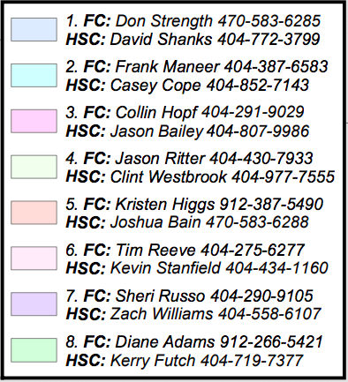

Slide 20
Risk Assessment and Planning
TCT Survey Procedures:
Interview the RHC leadership and ask them to describe the RHC’s emergency preparedness program.
Ask leadership to identify hazards (e.g. natural, man-made, etc.) that were identified in the RHC’s risk assessment, why they were included and how the risk assessment was conducted.
Ask leadership to describe the following:.
a. The clinic’s patient population that would be at risk during an emergency;
  b. Services the clinic would be able to provide during an emergency; how it continues to provide operations during an emergency; and delegations of authority and succession plans.

Slide 21
Risk Assessment and Planning
TCT Survey Procedures Con’t.:
Review the plan to verify it contains the following required elements:
  A documented, clinic-based and community-based risk assessment.
  Strategies for addressing emergency events identified by the risk assessment.
  Addresses patient population, including, but not limited to, the type of services the clinic has the ability to provide in an emergency; and continuity of operations, including delegations of authority and succession plans.

Slide 22
Risk Assessment and Planning
TCT Survey Procedures, Con’t.:
  Is there a process for cooperation and collaboration with local, tribal, regional, State and Federal emergency preparedness official’s?
  Is there documentation of the clinic’s efforts to contact such officials?
  Ensure the word “comprehensive” in the RHC’s emergency preparedness program considers a multitude of events, not one potential emergency.
  Verify that the plan is reviewed and updated annually.

Slide 23
Policies and Procedures
TCT Survey Procedures:
Verify the RHC’s policies and procedures:
    1. Provide for the safe evacuation of patients from the RHC.
    2. Include how it will provide a means to shelter in place for patients, staff and volunteers who remain in the RHC.
    3. Ensures the medical record documentation system preserve patient information, protects confidentiality of patient and secures and maintains availability of records
    4. Includes for the use of volunteers and other staffing strategies in its emergency plan.
When surveying the clinic, verify that all exit signs are placed in the appropriate locations to facilitate a safe evacuation.

Slide 24
Communication Plan
The RHC/FQHC must develop and maintain an emergency preparedness communication plan that complies with Federal, State, and local laws and must be reviewed and updated at least annually. The communication plan must include all of the following:
(1) Names and contact information for the following:
(i) Staff.
(ii) Entities providing services under arrangement.
(iii) Patients' physicians.
(iv) Other RHCs/FQHCs.
(v) Volunteers.

Slide 25
Communication Plan
Contact information for the following:
(i) Federal, State, tribal, regional, and local emergency preparedness staff.
(ii) Other sources of assistance.
Primary and alternate means for communicating with the following:
(i) RHC/FQHC's staff.
(ii) Federal, State, tribal, regional, and local emergency management agencies.

Slide 26
Rethinking the Phone Tree
Compile “advanced emergency phone trees” which not only requests staff member home phone numbers, but also:
Mobile numbers for text messaging
Email addresses for mass communication
Emergency family contact information
Alternate addresses in case of temporary relocation

Slide 27
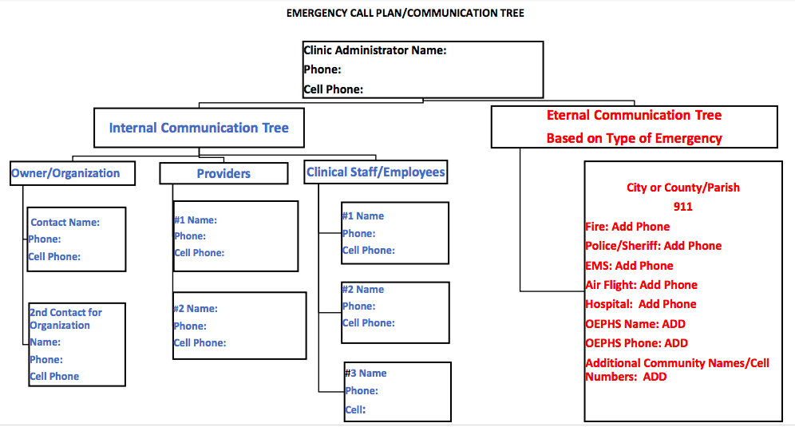
Communication Plan

Slide 28
Communication Plan
TCT Surveyor Procedures:
1. Ask to see the written communication plan.
2. Ask to see evidence that the plan has been reviewed (and updated as necessary) on an annual basis.
3. Verify that all required contacts are included in the communication plan by asking to see a list of the contacts with their contact information.

Slide 29
Communication Plan
TCT Surveyor Procedures Con’t:
4. Verify the communication plan includes primary and alternate means for communicating with clinic staff, Federal, State, tribal, regional and local emergency management agencies by reviewing the communication plan (i.e., pagers, cellular telephones, walkie-talkies, HAM radio, etc.)
5. Ask to see the communications equipment or communication systems listed in the plan.

Slide 30
Communication Plan
TCT Surveyor Procedures Con’t:
6. Verify the clinic has developed policies and procedures that address the means the clinic will use to release patient information to include the general condition and location of patients, by reviewing the communication plan
7. Verify the communication plan includes a means of providing information about the clinic’s needs, and its ability to provide assistance, to the authority having jurisdiction, the Incident Command Center, or designee by reviewing the communication plan.

Slide 31
Training and Testing
The clinic must develop and maintain an emergency preparedness training and testing program that is based on their emergency plan and risk assessment.
The training and testing program must be reviewed and updated at least annually.

Slide 32
Training and Testing
Training program.
The clinic must do all of the following:
(i) Initial training in emergency preparedness policies and procedures to all new and existing staff, individuals providing services under arrangement, and volunteers, consistent with their expected roles,
(ii) Provide emergency preparedness training at least annually.
(iii) Maintain documentation of the training.
(iv) Demonstrate staff knowledge of emergency procedures.

Slide 33
Training and Testing
The clinic must conduct exercises to test the emergency plan at least annually. The clinic must do the following:
Participate in a full-scale exercise that is community-based or when a community-based exercise is not accessible, an individual, facility-based.
If the clinic experiences an actual natural or man-made emergency that requires activation of the emergency plan, the RHC/FQHC is exempt from engaging in a community- based or individual, facility-based full-scale exercise for 1 year following the onset of the actual event.

Slide 34
Training and Testing
Conduct an additional exercise that may include, but is not limited to following:
(A) A second full-scale exercise that is community-based or individual, facility-based.
(B) A tabletop exercise that includes a group discussion led by a facilitator, using a narrated, clinically-relevant emergency scenario, and a set of problem statements, directed messages, or prepared questions designed to challenge an emergency plan.

Slide 35
Training and Testing
TCT Surveyor Procedures:
Interview various staff and ask questions regarding the clinic’s initial and annual training course, to verify staff knowledge of emergency procedures.
Review a sample of staff training files to verify staff has received initial and annual emergency preparedness training.

Slide 36
Training and Testing
TCT Surveyor Procedures Con’t:
Ask to see documentation of the annual tabletop and full-scale exercises (which may include, but is not limited to, the exercise plan, the AAR, and any additional documentation used by the RHC to support the exercise.
Ask to see the documentation of the clinic’s efforts to identify a full-scale
community based exercise if they did not participate in one (i.e. date and
personnel and agencies contacted and the reasons for the inability to participate
in a community based exercise).
Request documentation of the clinic’s analysis and response and how the facility
updated its emergency program based on this analysis.

Slide 37
Integrated Healthcare Systems
If a clinic is part of a healthcare system consisting of multiple separately certified healthcare facilities that elects to have a unified and integrated emergency preparedness program, the RHC/FQHC may choose to participate in the healthcare system's coordinated emergency preparedness program. If elected, the unified and integrated emergency preparedness program must do all of the following:

Slide 38
Integrated Healthcare Systems
Demonstrate that each separately certified facility within the system actively participated in the development of the unified and integrated emergency preparedness program.
Be developed and maintained in a manner that takes into account each separately certified facility's unique circumstances, patient populations, and services offered.
Demonstrate that each separately certified facility is capable of actively using the unified and integrated emergency preparedness program and is in compliance with the program.

Slide 39
Integrated Healthcare Systems
(4) Include a unified and integrated emergency plan that meets the requirements of paragraphs (a)(2), (3), and (4) of this section. The unified and integrated emergency plan must also be based on and include all of the following:
(i) A documented community-based risk assessment, utilizing an all-hazards approach.
(ii) A documented individual facility-based risk assessment for each separately certified facility within the health system, utilizing an all-hazards approach.
(5) Include integrated policies and procedures that include: A coordinated communication plan and Training and testing programs

Slide 40
Integrated Healthcare Systems
TCT Surveyor Procedures:
1. Verify whether or not the facility has opted to be part of its healthcare system’s unified and integrated emergency preparedness program. Verify that they are by asking to see documentation of its inclusion in the program.
2. Ask to see documentation that verifies the facility within the system was actively involved in the development of the unified emergency preparedness program.

Slide 41
Integrated Healthcare Systems
TCT Surveyor Procedures Con’t.:
3. Ask to see documentation that verifies the facility was actively involved in the annual reviews of the program requirements and any program updates.
4. Ask to see a copy of the entire integrated and unified emergency preparedness program and all required components (emergency plan, policies and procedures, communication plan, training and testing program).
5. Ask facility leadership to describe how the unified and integrated emergency preparedness program is updated based on changes within the healthcare system such as when facilities enter or leave the system.

Slide 42
RHC Specifics
Outpatient providers are not required to have P&Ps for the provision of subsistence needs.
RHCS must still have a P&P detailing how refrigerated medications will be handled during/after disasters that disrupt electrical power.
RHC procedure may be to evacuate staff/patients when safe to do so, close/secure the clinic, and notify staff/patients that the clinic is closed until further notice.

Slide 43
CAH Differences
CFR 485.625 addresses Critical Access Hospitals in the same way as CFR 491.12 addresses RHCs. There are some additions to the CAH requirements:
1. The CAH must implement emergency and standby power systems based on their emergency plan.
2. The provision of subsistence needs for staff and patients, whether they
evacuate or shelter in place include, but are not limited to:
A. Food, water, medical, and pharmaceutical supplies;
B. Alternate sources of energy to maintain:
(a) Temperatures to protect patient health and safety and
for the safe and sanitary storage of provisions;
(b) Emergency lighting;
(c) Fire detection, extinguishing, and alarm systems; and
(d) Sewage and waste disposal.

Slide 44
Thank You
Jeff Harper
InQuiseek
jharper@inQuiseek.com
(318)243-5974

