Slide 1
Jim Langford – Georgia Prevention Project November 5, 2018
Opioid Misuse prevention and strategies for good outcomes

Slide 2
The Georgia Prevention Project
The Georgia Prevention Project is a statewide prevention program aimed at reducing the use of dangerous substances among teens and young adults.
We accomplish our work through awareness campaigns, educational programming and strategic partnerships with national and community based organizations.

Slide 3
Original Program – 2009-2014
Georgia Meth Project

Slide 4
Georgia Meth Project
Mass media campaign – heavy saturation
26,000 radio spots
23,000 television spots
588 billboards
33 million Georgia views of on-line ads
80,000 students reached in classrooms

Slide 5
Georgia Meth Project
Achieved significant and measurable results:
Changed meth risk perception by teens.
Made meth use “uncool” and meth lifestyle “undesirable”.
Changed risk perceptions for other substances.

Slide 6
Georgia Prevention Project
Expanded mission since 2014:
Opioids and heroin education.
Substance use disorder training course for educators.
Teen Advisory Council (TAC): peer-to-peer education.
College Prevention Program (CPP).
Substance Abuse Research Alliance (SARA).

Slide 7
Georgia Prevention Project
Our Discussion Today:
Why focus on opioids and heroin?
How do we turn the tide of this epidemic?
Why haven’t traditional approaches worked?
What are the characteristics of new methods?
What should you be doing to help?

Slide 8
Why focus on opioids and heroin?
A growing national epidemic over the past 10 years.
Opioid and heroin use in Georgia is on the rise – following national trends:
1,619 Georgia overdose deaths in 2017
– a 29% increase since 2014
1,043 Georgia overdose deaths from opioids in 2017
– a 41% increase since 2014
Heroin and synthetic opioids (fentanyl) overdoses on a dramatic rise.

Slide 9
Opioids and Heroin on the Rise

Slide 10
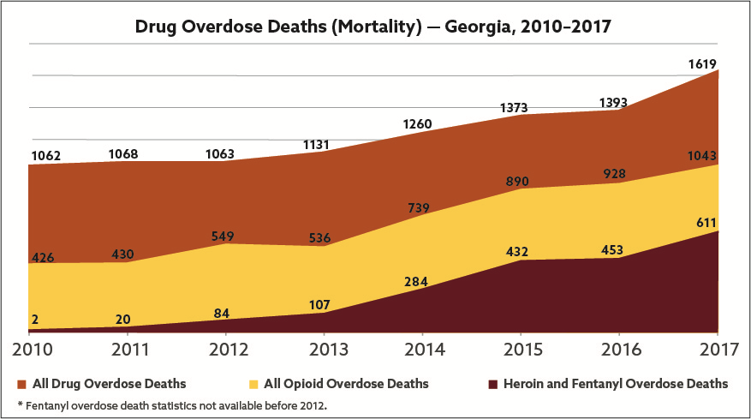
Georgia Overdose Deaths on the Rise
All Overdose Deaths
All Opioid Deaths
Heroin and Fentanyl Deaths

Slide 11
How do we turn the tide?
Comprehensive, coordinated and urgent responses.
Non-traditional approaches across the board.
Using advice and models from other states.
New funding at all levels.
Federal, state, local.
Non-profit and for-profit.

Slide 12
Why haven’t traditional methods worked?
Traditional substance use disorder programs:
Poorly funded.
Little sense of urgency.
Relatively stable substance use trends.
Death rates low relative to substance use.
Prevention work not focused well enough on target populations with relevant programs.

Slide 13
Why are the characteristics of new methods?
Better planning, coordination and sense of urgency.
More funding at every level.
More nimble.
More reliant on timely data.
Use of cutting-edge marketing techniques that target specific demographics.

Slide 14
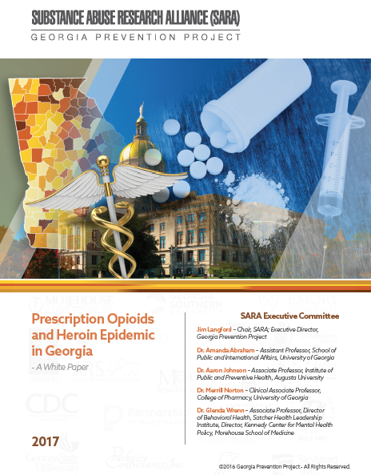
SARA White Paper:
Opioids and Heroin Epidemic in Georgia
V 1 - January, 2017
V 2 - December, 2017
Can download at: www.sara-ga.org

Slide 15
Increasing Activity in Georgia: 2016-17
2016: GA State Senate creates Opioid Study Committee.
2016 - 2017: SARA publishes White Paper V1.0 and V2.0.
2016: SARA recommends legislation and statewide plan.
2016: Lt. Governor convenes Health Reform Task Force.
2017: GA Legislature passes two SARA recommendations.
2017: GA Department of Public Health begins planning.
2017: GA Attorney General convenes Statewide Task Force.

Slide 16
Additional Gains: 2018
2018: Georgia Legislature passes multiple bills.
2018: Georgia Department of Public Health releases statewide plan. Implementation begins.
2018: Elected leaders fully engaged.

Slide 17
Additional Recent Gains
New Federal funds - $6 billion – across many agencies.
Many states are creating and implementing comprehensive plans.
Overdose death rates starting to turn down in some states.
Number of opioid prescriptions and doses starting to decline as prescriber guidelines, individual state efforts and lawsuits start to have an effect.
Stigmas are beginning to dissipate as the epidemic reaches more households across all demographics.

Slide 18
How Do We Win the Battle
Against Opioids and Heroin?
Good coordinated plans and implementation.
Better control of opioid sources.
Education of parents and kids about opioid pills.
Better and more treatment and recovery options.
More creative approaches to teen education.
Implementing stronger “infrastructure” for prevention, treatment and recovery.

Slide 19
How can you help?
Get familiar with the DPH strategic plan.
Volunteer to participate in implementing the plan.
Find ways to plug your organization’s efforts into the plan.
Follow the data on the DPH website.
Help educate parents about what they should do.
Help teachers get trained in how to teach students about substance use disorder.

Slide 20
Final Thoughts
It’s going to take a long time to turn this around.
But we must take fast action to curb new addictions and stop the death rates.
Shutting off the pills isn’t going to solve everything.
We must take a long view about how to avoid future epidemics.

Slide 21
Resources
CDC prescriber guidelines: https://www.cdc.gov/drugoverdose/pdf/guidelines_factsheet-a.pdf
PDMP monitoring: http://www.pdmpassist.org/pdf/Prescription_Monitoring_Goals.pdf
NIDA state information: https://www.drugabuse.gov/drugs-abuse/opioids/opioid-summaries-by-state/
SAMSHA Overdose Prevention Toolkit: https://store.samhsa.gov/product/Opioid-Overdose-Prevention-Toolkit/SMA18-4742
Georgia Prevention Project: www.georgiapreventionproject.org
Jim Langford, Executive Director; email – jlangford@georgiapreventionproject.org
tel. – 404-831-1959

