Slide 1


Integration of Behavioral Health & Primary Care
Georgia Rural Health Association
Rural Health Clinic Conference
Savannah, GA
December 2017
ASPIRE Behavioral Health and Developmental Disability Services –
Kay Newberry Brooks, CEO
ASPIRE - a unit of Albany Area Community Service Board
Leading Our Communities Towards Health, Hope, & Recovery

Slide 2

Integration of Behavioral Health & Rural Health Revealed
Learning Objectives
  What, Why and How of Integrated Care?
  Behavioral Health – What??
  Intellectual/Developmental Disability – What??
  Georgia BH/DD Safety Net Providers – Who??
  Identifying needs of your community/agency
  Identifying strengths/challenges of your community/hospital/agency
  Collaboration/Partner Opportunities
  Building a Safer, Healthier community

Slide 3
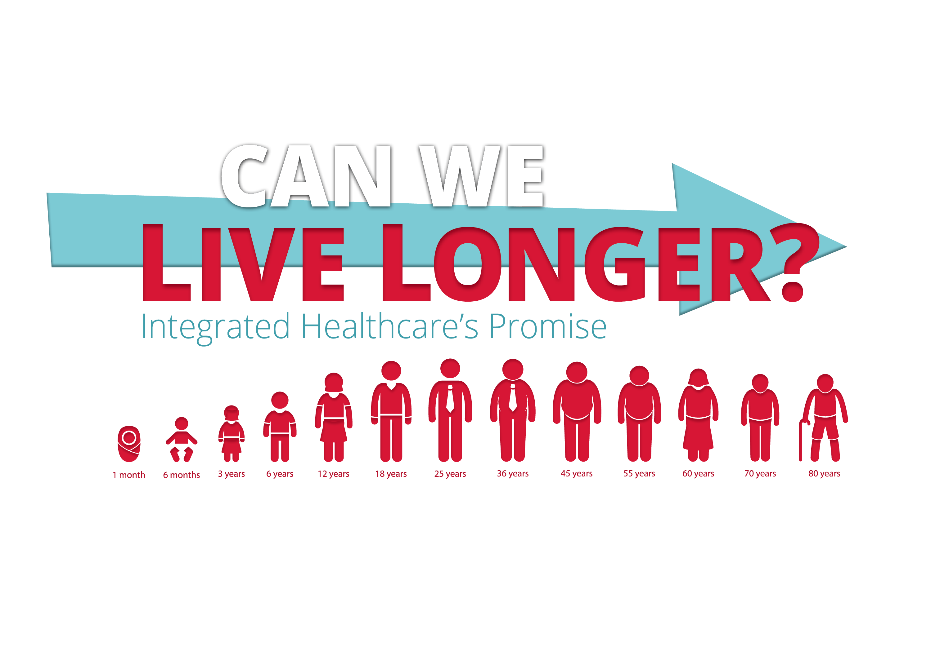


Slide 4
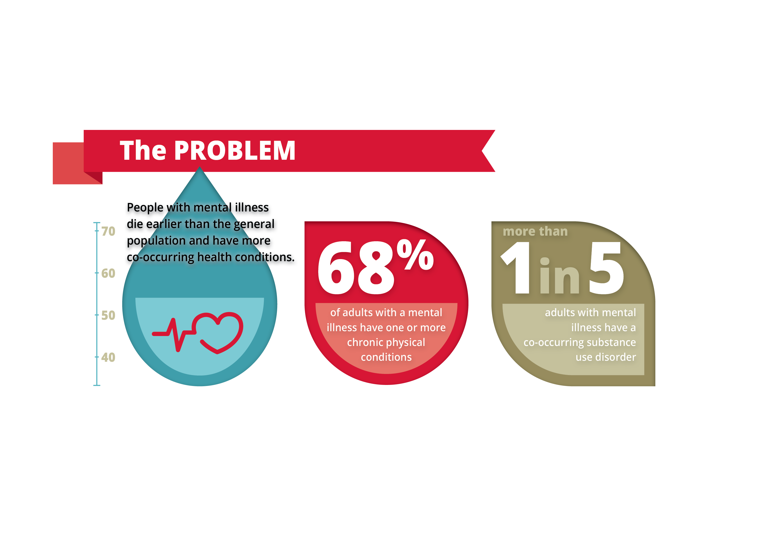

Slide 5
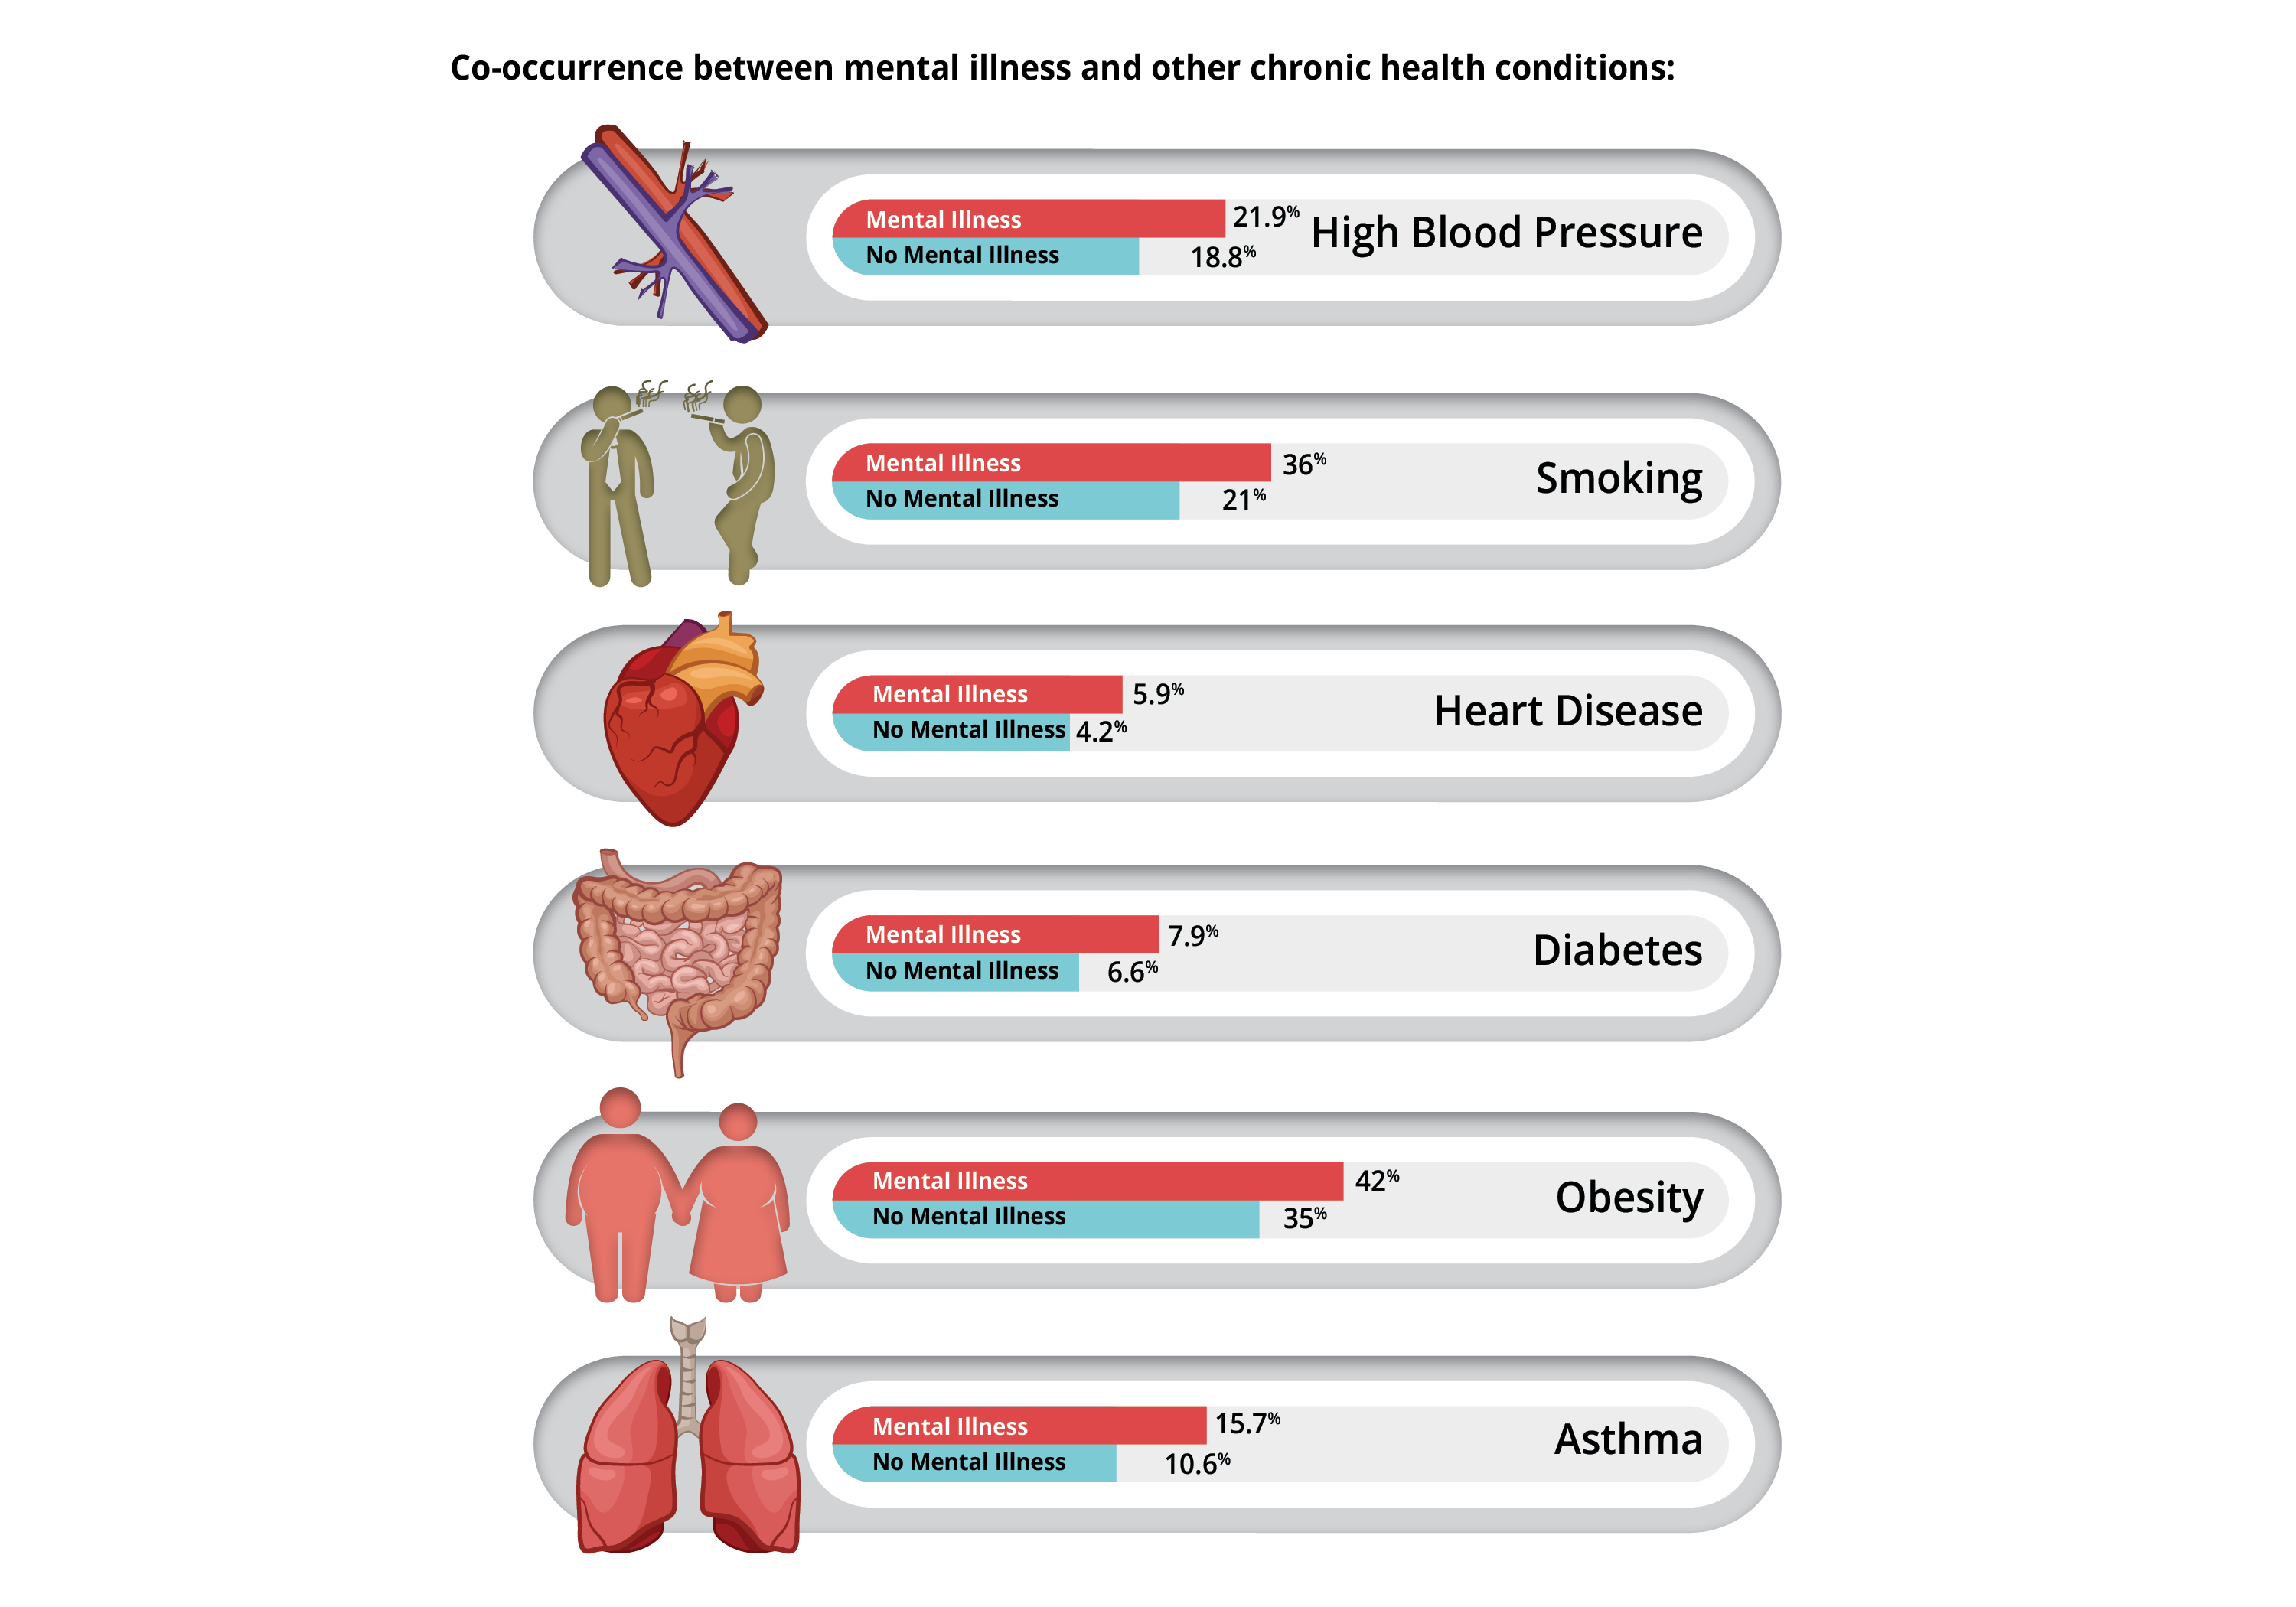

Slide 6
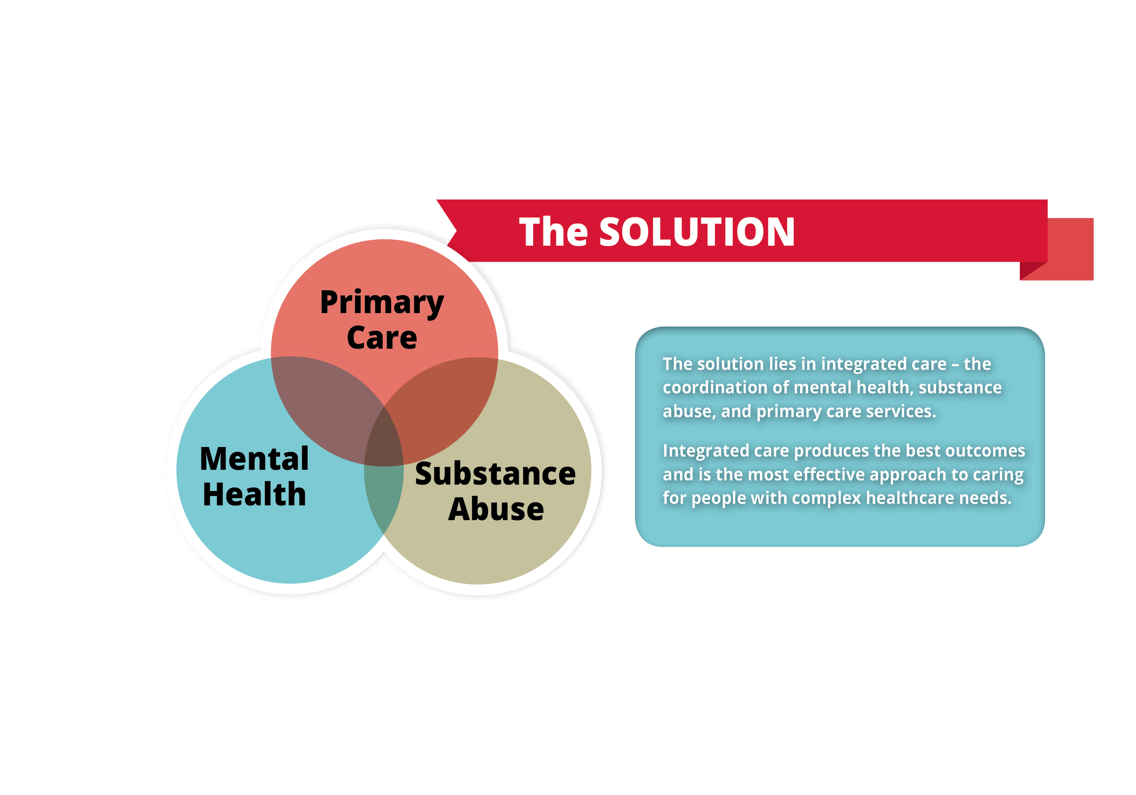

Slide 7
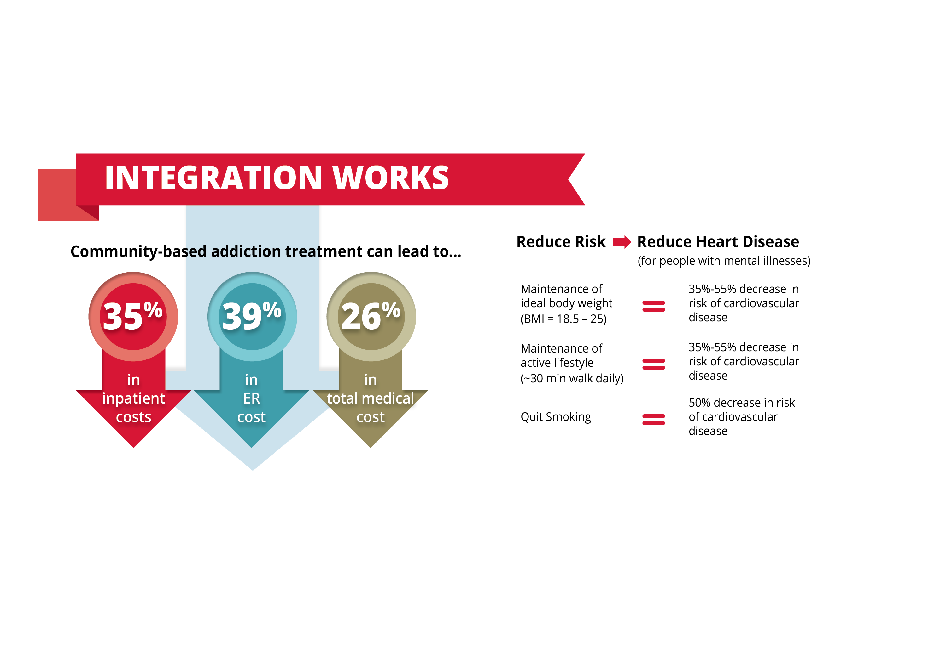

Slide 8
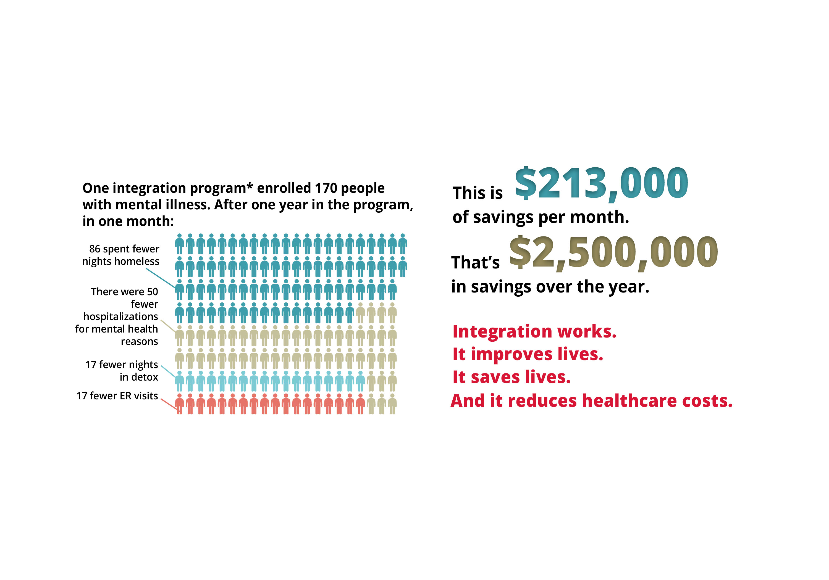

Slide 9
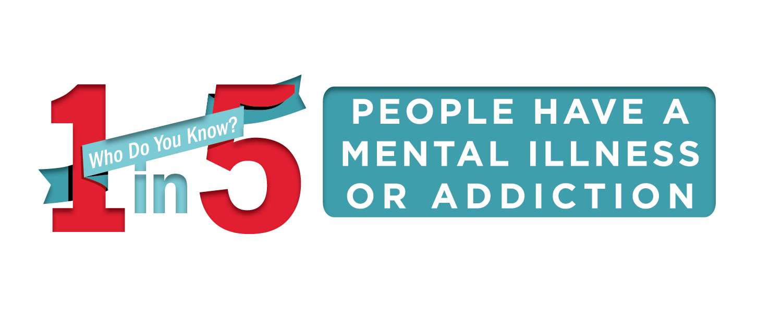

Slide 10
What is Integrated Care?
Abstract: People with mental and substance abuse disorders may die decades earlier than the average person
People with mental and substance abuse disorders may die decades earlier than the average person — mostly from untreated and preventable chronic illnesses like hypertension, diabetes, obesity, and cardiovascular disease that are aggravated by poor health habits such as inadequate physical activity, poor nutrition, smoking, and substance abuse. Barriers to primary care — coupled with challenges in navigating complex healthcare systems — have been a major obstacle to care.
At the same time, primary care settings have become the gateway to the behavioral health system, and primary care providers need support and resources to screen and treat individuals with behavioral and general healthcare needs.
The solution lies in integrated care, the systematic coordination of general and behavioral healthcare. Integrating mental health, substance abuse, and primary care services produces the best outcomes and proves the most effective approach to caring for people with multiple healthcare needs.
Whether services are organized via traditional models within primary care settings or behavioral health settings – or are Health Homes models, CIHS gathers current developments, research, models, and other important resources to ensure the success of healthcare’s future: integration. CIHS

Slide 11
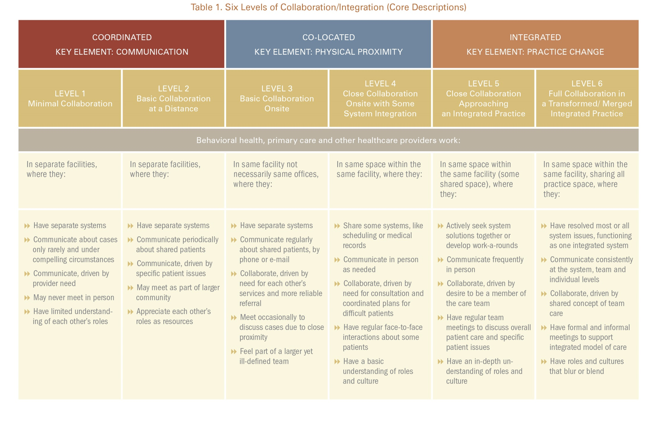
Heath B, Wise Romero P, and Reynolds K. A Review and Proposed Standard Framework for Levels of Integrated Healthcare. Washington, D.C.SAMHSA-HRSA Center for Integrated Health Solutions. March 2013

Slide 12
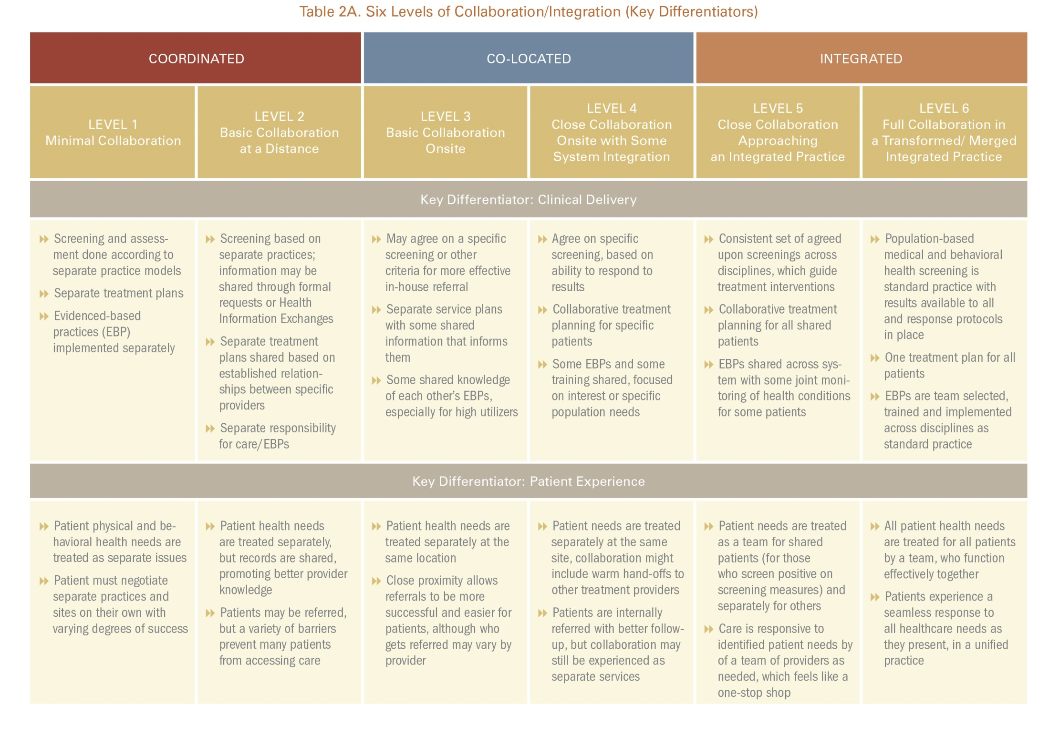
Heath B, Wise Romero P, and Reynolds K. A Review and Proposed Standard Framework for Levels of Integrated Healthcare. Washington, D.C.SAMHSA-HRSA Center for Integrated Health Solutions. March 2013

Slide 13
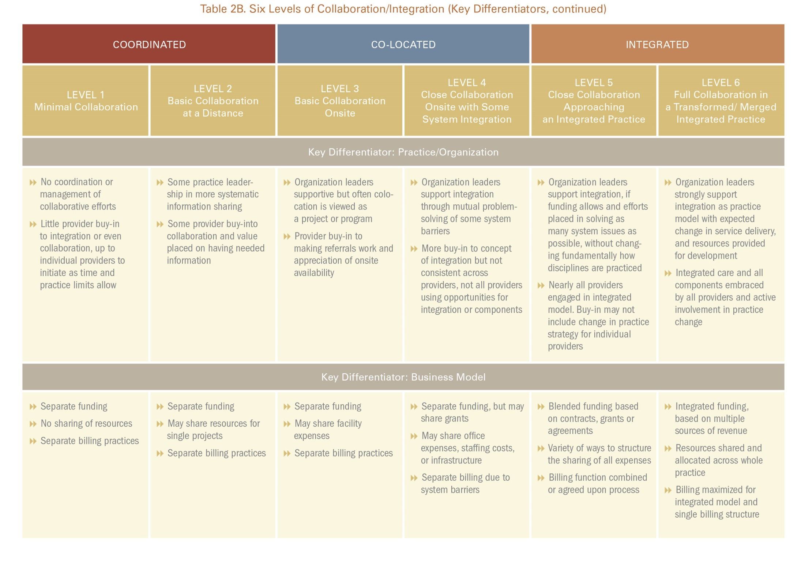
Heath B, Wise Romero P, and Reynolds K. A Review and Proposed Standard Framework for Levels of Integrated Healthcare. Washington, D.C.SAMHSA-HRSA Center for Integrated Health Solutions. March 2013

Slide 14
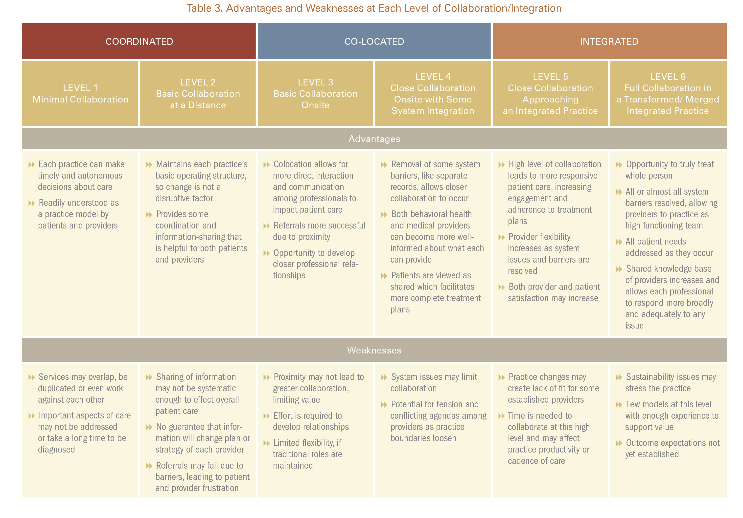
Heath B, Wise Romero P, and Reynolds K. A Review and Proposed Standard Framework for Levels of Integrated Healthcare. Washington, D.C.SAMHSA-HRSA Center for Integrated Health Solutions. March 2013

Slide 15

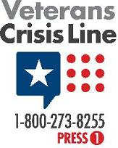

Behavioral Health ??
Behavioral Health refers to a person’s state of being and how their behaviors and choices affect their overall health and wellness. Substance abuse and addictions of all kinds fall into the realm of behavioral health.
Behavioral health is an umbrella term that refers to your overall wellbeing and how it is impacted by your behaviors. Because behavior is something that is generally seen as changeable, people suffering from behavioral health issues can be empowered by knowing that their own choices can prevent, cure, or decrease symptoms of a variety of behavioral health disorders. Behavioral health is just as complex as mental health, and the two terms are often used interchangeably.
Many mental health issues may be impacted by behavior, many mental health disorders have neurological or biological causes, meaning that simply changing a person’s behavior may not cure them of that illness. www.projectknow.com

Slide 16

What Is Mental Health?
Mental health includes our emotional, psychological, and social well-being. Our mental health affects how we think, feel, and act.
Over the course of our lives, if you experience mental health problems, your thinking, mood, and behavior could be affected. Many factors contribute to mental health problems, including:
  Biological factors, such as genes or brain chemistry
  Life experiences, such as trauma or abuse
  Family history of mental health problems
Mental health problems are common, treatment is available!
www.mentalhealth.gov

Slide 17
Addictive Disease
According to the Substance Abuse and Mental Health Services Administration (SAMHSA), substance use disorders result from recurrent use of alcohol or drugs that causes clinically and functionally significant impairments.
Addiction treatment programs can help people of all ages withdraw safely from the physical and psychological effects of drugs, learning to manage their substance use disorder.

Slide 18
Intellectual/Development Disabilities
Intellectual disability refers to a group of disorders characterized by a limited mental capacity and difficulty with adaptive behaviors such as managing money, schedules and routines, or social interactions.
Developmental disability is a severe, long term disability that can affect cognitive ability, physical functioning, or both.
nih.gov

Slide 19
Recovery Focused Services
Recovery is possible!
This belief guides the approach to mental health, addiction treatment and developmental disability services.
Services are centered on clients and focused on their recovery journeys! Helping them to achieve their goals, discover their strengths and identify what they need to make their recovery a reality.

Slide 20



Slide 21


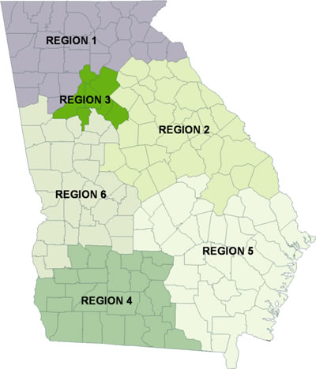
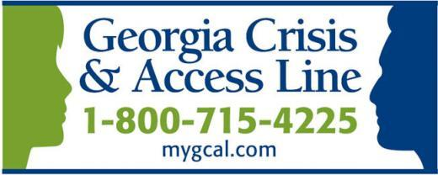
Georgia Department of Behavioral Health and
Developmental Disability
System of Care
Commissioner Judy Fitzgerald
If you or a loved one needs help dealing
with a behavioral health crisis,
the Georgia Crisis and Access Line (GCAL) offers free and confidential crisis intervention 24/7.

Slide 22
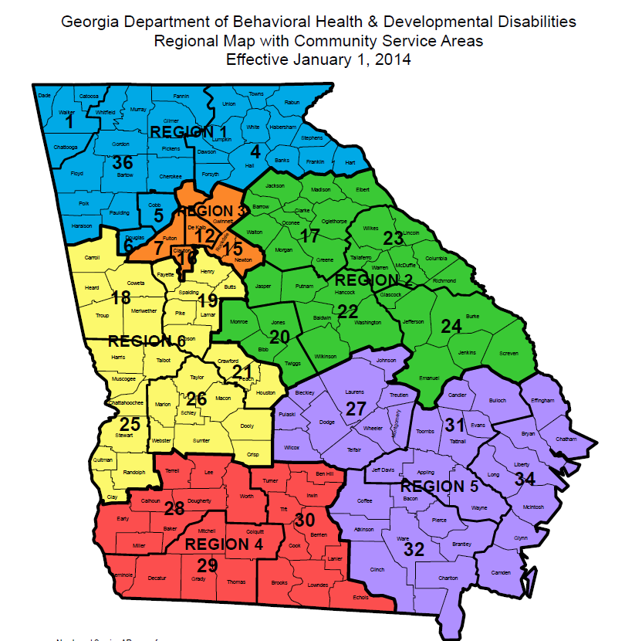

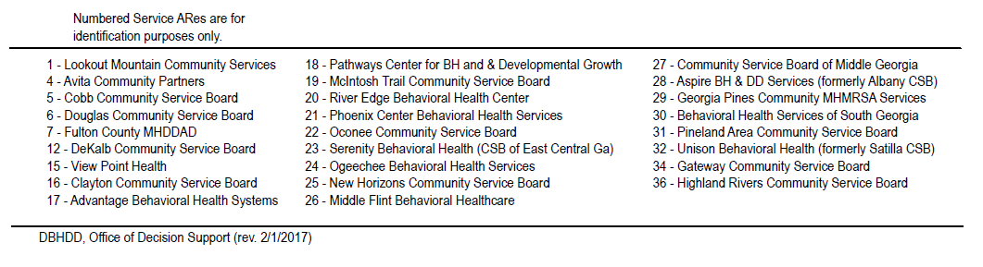

Slide 23
Georgia's Community Services Boards are the pre-eminent providers for children, youth and adults with serious mental illness, developmental disabilities, and addictive diseases. Recent surveys * indicate that:
- Nearly two million Georgians suffered from mental illness and / or addictive disease in the past year
- Over 320,000 experienced a serious mental illness in the past year
- There are over 145,000 adults in Georgia with intellectual / developmental disability
Of the SMI, the Community Service Boards served over 175,000 with high quality, cost effective care to Georgia’s most vulnerable population.
To learn more about the vital contributions of Georgia’s Community Service Boards to help persons with these disabilities go to: www.gacsb.org
*US Department of Health and Human Services and Bethesda Institute

Slide 24

VISION
Leading our communities toward
Health, Hope & Recovery!
MISSION STATEMENT
To offer Affordable, Accessible, and Quality Mental Health, Addictive Disease and Developmental Disability services by skilled professionals who are sensitive to the needs of individuals and families served.

Slide 25
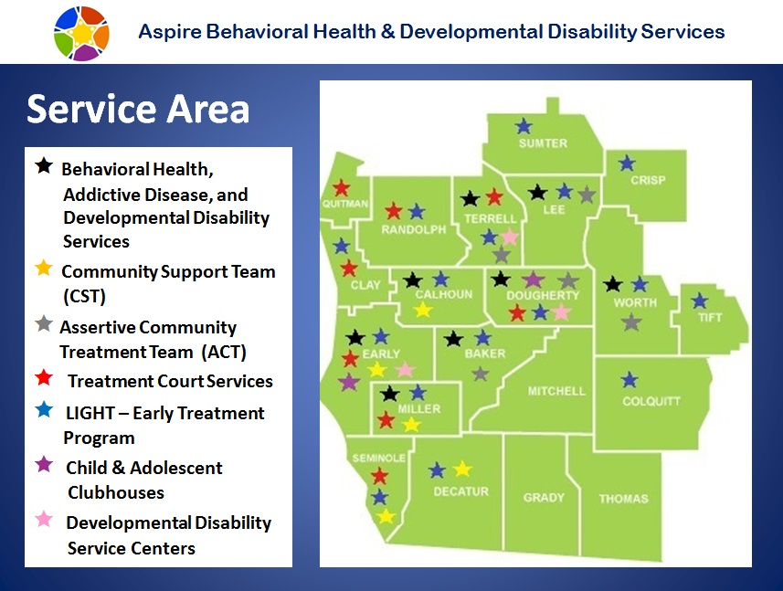
8,182 Square Mile Service Area
Poverty Rate: 24.6% SW GA | 16.5% GA | 14.7% Entire US | 17.2% Rural US

Slide 26

ASPIRE – 2016 Out Patient Behavioral Health Services - SPMI
Unduplicated MH/AD Adult Clients | Unduplicated Child & Adolescent MH/AD Client | Total Unduplicated MH/AD Clients
5001 | 992 | 5993

Slide 27

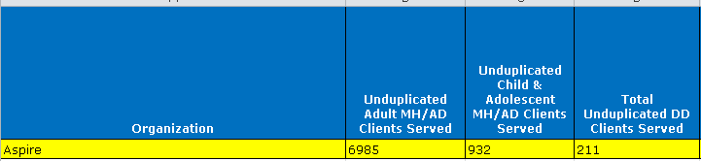
ASPIRE – 2017 Out Patient Behavioral Health Services - SPMI

Slide 28

Community Collaborations
Collaborations with primary care providers and hospitals
Collaborations with schools
DFACS
Behavioral Health Coalition
Homeless Coalition
Community Conversations
Do Co Coroner’s Office – Suicide Prevention
Council on Aging
Albany Transition Center/Daily Reporting Centers
Universities/colleges w/ internship opportunities for RNs, SW, LPCs, LPNs, etc.
Numerous local, state and national advocacy groups

Slide 29
Building Community Partnerships
Educating Community and Stakeholders
Accountability Court Partnerships
CIT Trainings in partnership with NAMI since 2004
Law Enforcement/First Responders
Jail Partnerships
State of GA Community Supervision
Homeless Coalition
Community Coalitions

Slide 30

Children / Adolescents – At Risk Population
Children who have not developed social/emotional skills by the time they enter school are at a disadvantage.
Students with poor social skills are more likely to:
experience difficulties in interpersonal relationships with teachers and peers; show signs of depression, aggression, or anxiety; demonstrate poor academic performance; and have a higher incidence of involvement in the criminal justice system as adults.
Approximately 50 percent of students age 14 and older with a mental illness drop out of high school.
This is the highest dropout rate of any disability group.
Without adequate treatment, young adults in college with a mental illness are more likely to receive lower GPAs, drop out of college, or be unemployed than their peers who do not have a mental health challenge.
31% of college students have found it difficult to function due to depression in the past year,
while more than 50 % have felt overwhelming anxiety, making it hard to succeed academically.

Slide 31
Behavioral Health is a
Public Health Challenge!
In Georgia, over 2.3 million face the challenge of living with mental illness; 1 in 3 will receive treatment.
1 out of 4 adults will experience at least one behavioral health illness in their lifetime!
In U.S. death by suicide happens every 16 minutes
In Georgia, suicide is the 11th leading cause of death
In U.S. 22.1 million with substance abuse and 17.9 million with alcohol dependence or abuse
41% of Georgians with addictive diseases report needing treatment but are not receiving
One out of every 10 families are affected by intellectual disabilities
111,000 children in Georgia live with serious mental illness.
Adults with a co-occurring ICD-9 mental health disorder (in addition to substance dependence) was 48% for 50- to 64-year-olds and 61% for those aged 65 and over.
Opioid epidemic – increasing demand for addiction services – especially with elderly
Robust Accountability Court services
Strong referral system to BH continuum of care for Individuals returning to community

Slide 32
Severe and Persistent Mental Ill (SPMI)
Morbidity and Mortality in People With Serious Mental Illness
National Association of State Mental Health Program Directors (NASMHPD) 2006 Report
Individuals with Serious Mental Illness are dying approximately 25 years earlier than the general population due to medical conditions
– Average age of death is 53
Substance Use Disorders and the Person-Centered Healthcare Home, a 2010 report by Barbara Mauer, finds that those with co-occurring mental illness and substance use disorders were at greatest risk
– Average age of death is 45

Slide 33
  Severe and Persistent Mental Ill (SPMI)
  Morbidity and Mortality in People With Serious Mental Illness
  National Association of State Mental Health Program Directors (NASMHPD) 2006 Report
  60% of premature deaths are due to preventable medical conditions:
    Metabolic and Cardiovascular Disease
    Diabetes
    Respiratory Disease
    Infectious Disease
    Cancer
    Obesity
  Example: recent Johns Hopkins Medicine studies published
    July 2012 Psychiatric Services: SMI are 2.6 times more likely to develop cancer
    July 2012 Injury Prevention: SMI are nearly twice as likely to end up in ER suffering from an injury and 4.5 times more likely to die from their injuries.

Slide 34

Perceptions of Violence and Mental Illness
Criminal Justice Involvement
There are high rates of mental illnesses and substance abuse problems among people in the criminal justice system.
Approximately 70 % of jail inmates with mental illnesses are incarcerated for non-violent offenses.
56 % of state prisoners, 45 % of federal prisoners, and 64 % of jail inmates report a behavioral health diagnosis.
Sixty-seven to seventy % of youth in the juvenile justice system have a diagnosable mental disorder.
Individuals with mental illnesses only commit three to five % of violent acts every year.
People with mental illnesses are much more likely to be victims of crime than perpetrators.

Slide 35
Georgia Department of Corrections/Juvenile Justice
1 in 4 Georgians affected by MI (Mental Illness)
33-75% jail population with mental illness or addiction related offenses
15-16% GDC inmates with MI
75% of YDC population with MI or SED
Georgia home to 4 of 50 largest US jails
  DeKalb County, #30 (ADP – 3,117)
  Fulton County, #32 (ADP – 2,970)
  Gwinnet County, #36 (ADP – 2,716)
  Cobb County, #42 (ADP – 2,510)
  *ADP=Average Daily Population

Slide 36
Behavioral Health Needs of a Community
Early intervention- key to recovery
Easy access to services
Affordable services
Evidence based treatment – team approach
Community based services (out of clinic)
Stakeholder collaboration
Positive outcomes

Slide 37

Behavioral Health Recovery is built on:
Appropriate Level of Care with appropriate community support services.
Health—overcoming or managing one’s disease(s) or symptoms – including abstinence if one has an addiction – and making informed, healthy choices that support physical and emotional wellbeing.
Home—a stable and safe place to live.
Purpose—meaningful daily activities, such as a job, school, volunteerism, family caretaking, or creative endeavors and the independence, income, and resources to participate in society.
Community—relationships and social networks that provide support, friendship, love, and hope.

Slide 38

Partnership Benefits
Maximize available resources
Capitalize on Expertise
Collaborative Case Coordination to enhance recovery focused services
Healthy and Safe Families and Communities
Helping one, changing all!

Slide 39

Behavioral Health Provider
Challenges
Stigma
Confidentiality
Limited awareness of mental health/substance abuse symptoms and treatment
Isolation/Transportation
Ability to pay for service- uninsured; Inability to pay for premiums and/or deductibles
Homelessness
Competent behavioral health workforce
Behavioral Health Workforce shortage
Co-occurring – complex cases – BH case management needs
Employment support services
Collaboration/Partnerships Matter

Slide 40
Community/Agency Challenges
Access to Support, Services, Treatment and Stigma
Not only can the attitudes and beliefs of the individual / Family in need prevent a person from seeking treatment, although research tells us that treatment is effective and people do recover.
Health Profession, First Responders, community agencies - attitudes and beliefs are important!
Only 38 percent of adults with diagnosable mental health conditions get treatment.
Less than one in five adolescents get treatment for diagnosable mental health conditions.

Slide 41
Paying for Behavioral Health Care
Lack of ability to afford care is among the top reasons that people with unmet behavioral health needs do not seek treatment.
People with mental health and substance abuse problems have historically had high rates of being uninsured.
Mental health and substance abuse treatment spending has depended more on public payers than all health care, with public payers— such as Medicaid—accounting for approximately 60 percent of mental health spending.
Significant challenge in Southwest Georgia is the high rate of un-insured individuals.
Georgia Health News states:
“A map of exchange enrollment in GA in 2014 shows generally low participation rates in rural South Georgia, even though these counties have high percentages of uninsured residents.”
“For the current year, Southwest GA in particular had high premiums compared with other Georgia regions. In fact, it had among the highest premiums in the nation.”
As a safety net provider in the DBHDD System of Care our agency - Aspire provides services for a large population that met BH service criteria and have no means to pay – utilizing FFS reimbursement thru DBHDD.

Slide 42
An integrated health and substance use disorder treatment system
requires a diverse workforce…
That includes, mental health counselors, physicians, nurses, mental health treatment providers, care managers, and recovery specialists.
However, Medicare, restricts “billable” health care professionals to physicians (including psychiatrists), nurse practitioners and clinical nurse specialists, physician’s assistants, clinical psychologists, clinical social workers, and certain other specified practitioners.
Medicare does not include as billable mental health counselors who are trained to provide services for substance use disorders.
A 2015 American Journal of Alcohol and Drug Abuse article reports that rural substance abuse treatment centers, compared to urban centers, had a lower proportion of mental health clinicians.

Slide 43
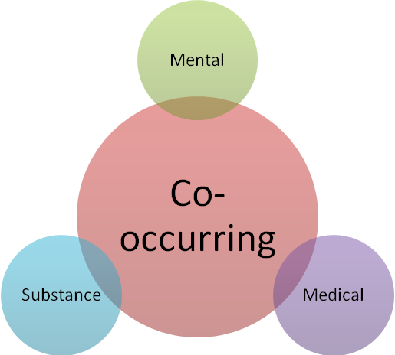
Challenge of Behavioral Health Services
Examples of Co-occurring Disorders
Mental disorders and medical disorders
Mental disorders and substance use disorders
Multiple mental disorders
Co-occurring Disorders
Risk factors for co-occurring mental disorders and substance use disorders include:
  Difficulty in school, relationship, employment, community
  History of trauma/loss
  Legal history
  Homelessness
Family history of substance use or mental illness
Examples of consequences include:
  Not sticking with treatment
  Problems with family
  Frequent use of emergency rooms or acute care clinics

Slide 44

Behavioral Health Professional
Workforce Shortage
Uneven geographic distribution
Recruitment challenges across the treatment field
Fragmented system of provider silos that compete for limited workforce

Slide 45
Competent Behavioral Health Workforce:
Community Support Staff
PEERS/CARES/CPS credentialed staff
Licensed Clinical Staff (LPC, LCSW, LMFT)
LPNs, RNs, NPs, APRNs, PAs
Primary Care Doctors, Psychiatrist

Slide 46

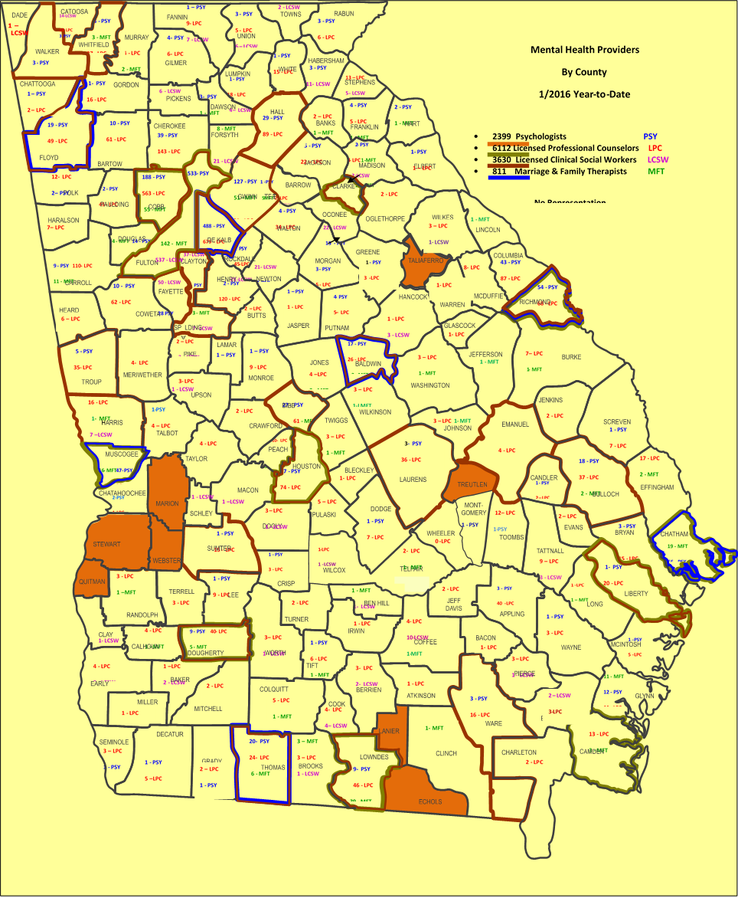
Georgia Mental Health Providers by County

Slide 47

What are your BH Challenges?
What are your solutions?
Can you provide BH services with out collaborating with a BH provider?
Can you provide BH community support services needed to promote long term recovery?
Can you access BH funding that is available to CSB providers?
(FFS/Specialty service funding)

Slide 48
NEEDS of SWGA:
Easy access to BH services - Integration of behavioral health and primary care services.
Case management services provided to coordinate bh/pc needs of individuals served.
Access to child and adolescent services to increase school attendance, improvement in grades, decrease disruptive behaviors and law enforcement involvement.
Access extended hours for behavioral health services to include early intervention, crisis behavioral health services, on-going community support services, group, individual, nurse and doctor services. Serve Calhoun, Baker, eastern Early, Southern Clay, Miller and Randolph and Terrell counties.
Access to out-patient SA services.
Access to shared Competent Behavioral Health Workforce
Expansion of Touchstone Residential Recovery to male/female specific units with a recovery focused environment.

Slide 49

OUTCOMES To Consider
With easy access to services, competent BH staff, appropriate treatment and community support services:
Improvement in care coordination between medical office/hospital/BH staff
Improvement in Treatment/Medication compliance
Stabilization of co-occurring medical/behavioral health concerns
Behavioral challenges decrease, school absence and suspension decrease
Emergency room visits, hospital stays, and periods of incarceration reduced.
High-risk and harmful substance use is decreased.
Employment opportunities for staff and individuals served

Slide 50

Behavioral Health ER Visits in SWGA
January to July 2015
Hospital | CO Population | ER visits | C/A | Early Adult | Adult | Admissions | Insurance | Cost
Miller County | 5,958 | 53 (40 ind) | 8 | 3 (early 20s) | 31 | 3 | 75% | 227,164
Early County | 10,491 | 93 | 14 | 5 | 54 | 5 | 75 % | 397,537
Randolph | 7,313 | 73 | 10 | 4 | 38 | 4 | 75 % | 279,412

Slide 51
Miller County Behavioral Health Expansion
Outpatient Behavioral Health Services offered close proximity to medical clinic and hospital.
Expansion of wide array of outpatient behavioral health services
Referrals, case management and outcomes
Community supportive services to participants to insure engagement with services

Slide 52
Need: LongTerm Residential Recovery Treatment in SWGA
Recently closed Calhoun County Hospital (2013) was a 25 bed hospital. The hospital 70+ staff continue to live in a 30 mile radius of this facility. Facility repurposed to 12 month Long term residential treatment facility with 54 FTEs and growing.

Slide 53
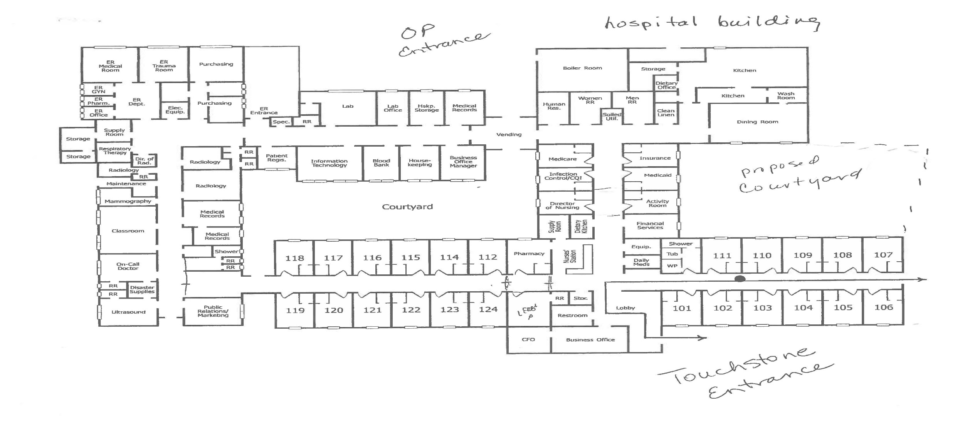

Arlington Hospital

Slide 54
Touchstone Residential Recovery
Aspire’s 12 bed male intensive residential recovery program relocated to this facility.
28 beds are located on separate wings (N/S). This unit is easily separated and secured from other units housed in the building. ASPIRE’s Touchstone Program for long-term SA recovery would be transitioned to this space.
Hospital building provides a recovery focused environment with expanded green space, privacy and activity areas.
The present 14 bed Touchstone program (male only) will be expanded to additional 14 female residents. Transitional beds will be available.
14 beds are presently DBHDD funded. Requesting additional funding from DBHDD for 14 beds. Additional beds will be available for other payor sources.
As research supports, longer length of stay would extend treatment, provide stability and support recovery skill building as well as provide support with transitions of employment, housing and family restoration.

Slide 55

Aspire – Calhoun Behavioral Health Services
Outpatient Behavioral Health Services will be offered on back hallway of building. Back entry way will have benches and trees/plants planted in large containers.
Outpatient BH Service Staff will provide services in surrounding counties.

Slide 56
FTE – 46/54(new jobs)
Touchstone – 18 (techs, LPN, .25 RN, .25 Dr, licensed BH staff)
contract staff for woodworking, art, horticulture, landscaping, pottery (2)
Outpatient – 8 (community support, LPN, .75, .25 Dr, licensed BH staff)
CM Collaboration with MCH – 5 case managers
Administrative support staff (clerical, billing, UM) 5
Support Services: Food Service, Housekeeping, Janitorial, Security, Transportation, yard maintenance – 10
Additional Aspire administrative staff maybe transitioned to this site. (6)

Slide 57
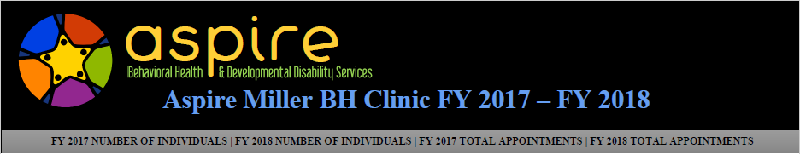
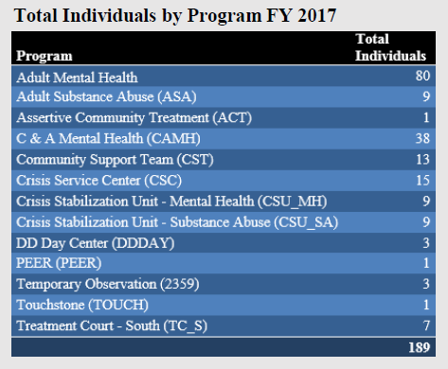
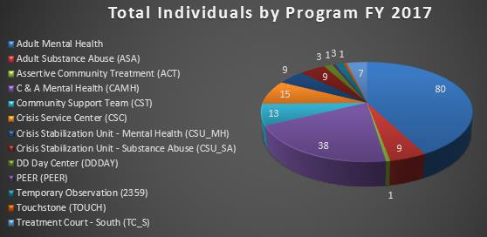
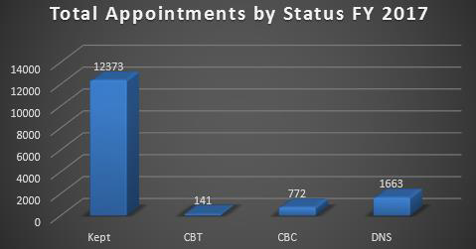
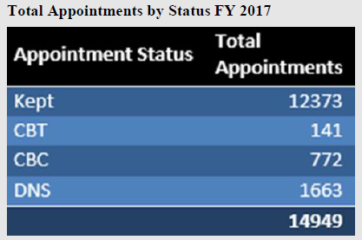


Slide 58

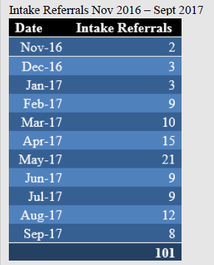
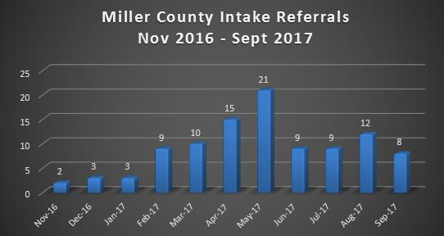
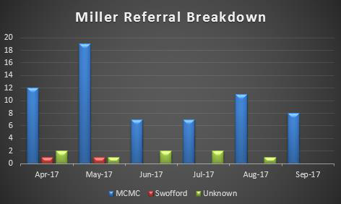
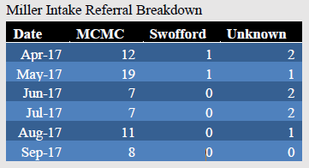

Slide 59
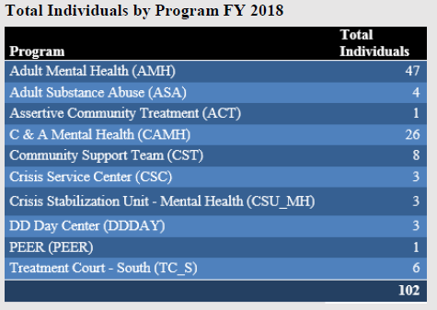
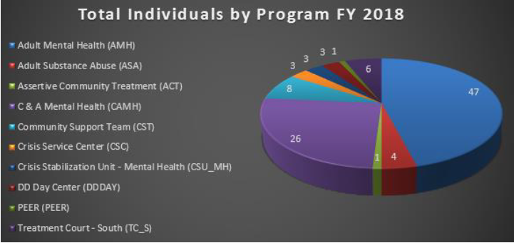
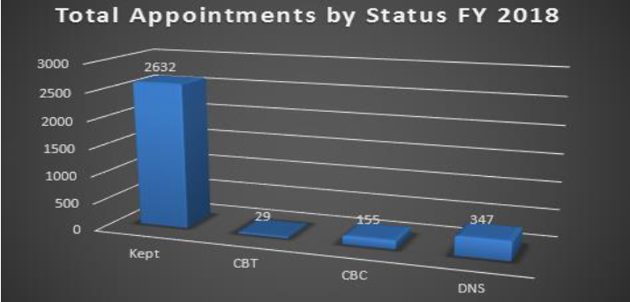
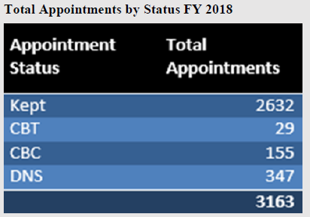


Slide 60

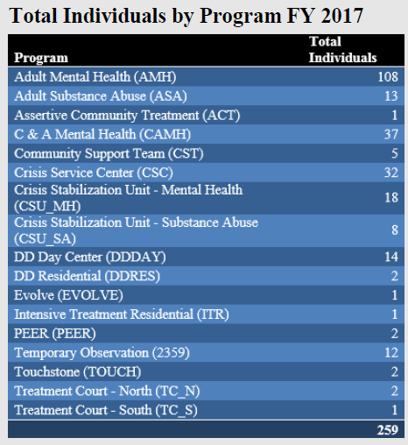
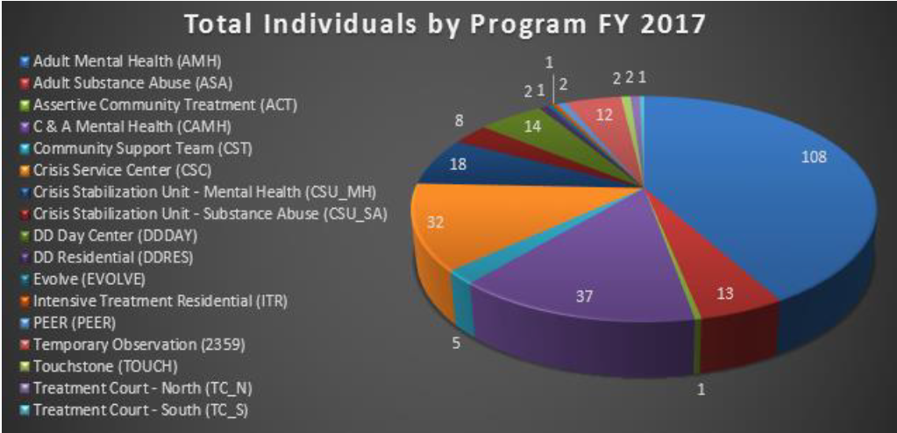
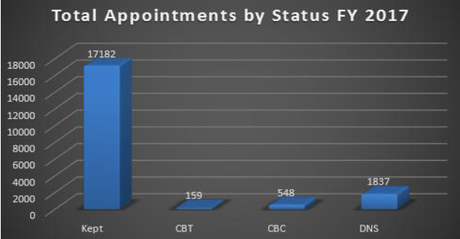
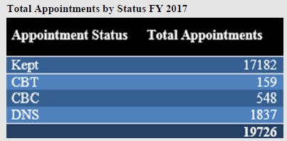


Slide 61

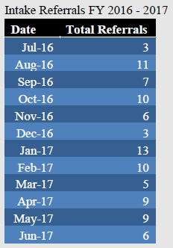
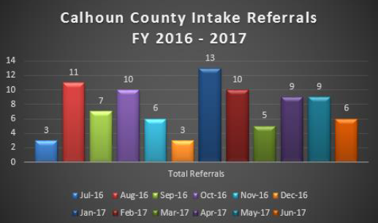
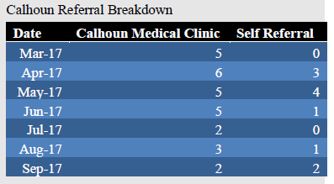
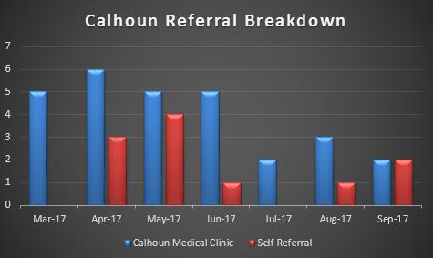
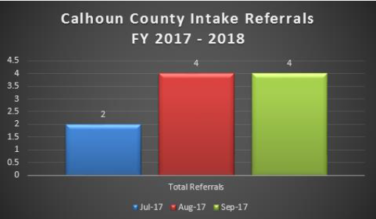
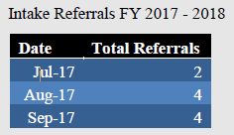

Slide 62
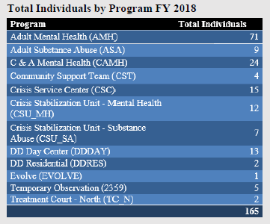
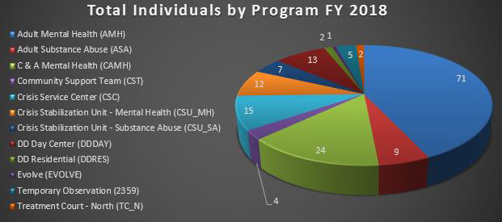
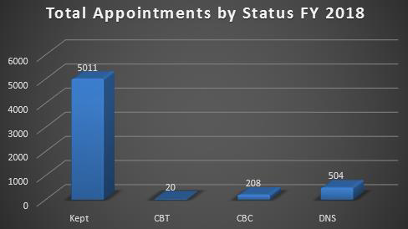
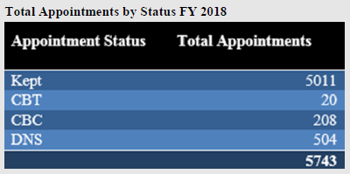


Slide 63

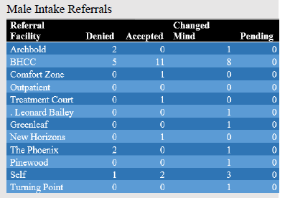
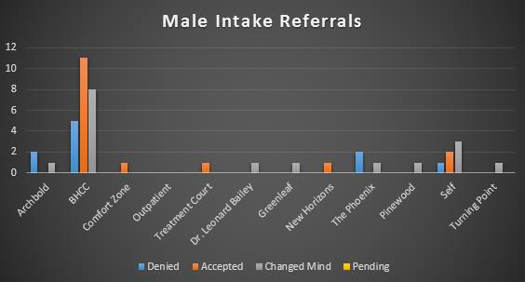




Slide 64
ASPIRE Behavioral Health and Developmental Disability Services –
Kay Newberry Brooks, EdD, LPC
Aspire Executive Director
229.430.4005
kbrooks@albanycsb.org

Slide 65


Slide 66
Resources:
Addressing Bullying http://www.stopbullying.gov
Appendix: Helpful Resources and Websites
(Note: These organizations, materials and links are offered for informational purposes only and should not be construed
as an endorsement of the referenced organization’s programs or activities.)
Children’s Mental Health Awareness Day http://www.samhsa.gov/children
Find Youth Info http://www.findyouthinfo.gov
Resources
Information About Mental Health • http://www.MentalHealth.gov
Additional information you could use to host a conversation in your community http://www.CreatingCommunitySolutions.org
sing Public Attitudes

Slide 67
Resources
National Institute of Mental Health (NIMH) http://www.nimh.nih.gov
National Registry for Evidence-Based Programs and Practices • http://www.nrepp.samhsa.gov
National Center for Trauma-Informed Care http://www.samhsa.gov/nctic
Children’s Mental Health Initiative Technical Assistance Center http://www.cmhnetwork.org
Recovery Support Services
National Consumer Technical Assistance Centers • http://ncstac.org/index.php
Homeless Resource Center http://www.homeless.samhsa.gov
Shared Decision Making in Mental Health Tools http://162.99.3.211/shared.asp
College Drinking: Changing the Culture http://www.collegedrinkingprevention.gov
Million Hearts http://millionhearts.hhs.gov/index.html
Resource Center to Promote Acceptance, Dignity, and Social Inclusion • http://promoteacceptance.samhsa.gov
Evidence-Based Practices for Treatment

Slide 68
Resources
SAMHSA-HRSA Center for Integrated Health Solutions: www.Integration.SAMHSA.gov
Substance Abuse and Mental Health Services Administration (SAMHSA) http://www.SAMHSA.gov
Suicide Prevention Resource Center • http://www.sprc.org
The Institute of Medicine’s Preventing Mental, Emotional and Behavioral Disorders Among Young People: Progress and Possibilities
http://www.iom.edu/Reports/2009/Preventing-Mental-Emotionaland-Behavioral-Disorders-Among-Young-People-Progress-andPossibilities.aspx
Voice Awards http://www.samhsa.gov/voiceawards
YouTube videos
  23 ½ Hours by Dr. Mike Evans
Monitoring tools and educational materials
  CDC: www.cdc.gov
  American Heart Association: www.heart.org
  American Diabetes Association: www.diabetes.org

