Slide 1
Association for Rural Health Professional Coding (ARHPC) presents: “ICD-10-CM – Review of the Key Guidelines for Coding & Reporting ” Georgia Rural Health Association
Gary Lucas, CPC, CPC-I, AHIMA ICD-10 Ambassador
Vice President, Education Operations
Gary@RuralHealthCoding.com

Slide 2
Before We Get Started…
All rights reserved. The slide deck has been provided to you for the purposes of this course only. The content of the slide contained herein may not be distributed or sold for any purpose unless written authorization is provided by ARHPC
ARHPC is not responsible for providing billing or legal advice. You and your organization are responsible for all code selections and billing as required by applicable payers to meet the False Claims Act and other regulatory rules.
CPT® nomenclature belongs to the AMA.

Slide 3
Faculty
Gary Lucas, M.Sc., CPC, CPC-I, AHIMA ICD-10 Ambassador
ARHPC - Vice President of Education Operations
Contact Information
Phone: 404-937-6633
Email: Gary@RuralHealthCoding.com
Web: http://www.RuralHealthCoding.com

Slide 4
The ARHPC Learning Center https://ARHPC.AbsorbTraining.com (Testing and eLearning courses can be found here)

Slide 5
Basic Agenda ~ 1 hour with Q&A
We will perform a high-level review of the “2017/2018 Official Guidelines for Coding & Reporting” which provides the most educational benefit related to diagnosis coding.
We will provide you with a tool that shows all of the 2018 ICD-10-CM changes that go into effect on October 1, 2017.

Slide 6
What Did Not Change With ICD-10-CM
Code reason for visit first
Code to the highest level of known specificity
Don’t code “probable, suspected, questionable or rule out”
Code chronic diseases as often and as long as the patient receives treatment for them
Code coexisting conditions affecting patient care at the time of the visit

Slide 7
Who Needs Coding and Billing Education?
Anyone involved in the revenue cycle
Billers, coders, non-clinical folks
All clinical staff
IT and EHR professionals
Does your EHR offer coding ‘recommendations’ (e.g., wizards)
Auditors and Statisticians - Its all about the data
Clinic managers, HR, Finance, and Facility Leadership
State and National Rural Health Associations
Documentation – Coding – Reporting – Auditing – Education – then REPEAT

Slide 8
Take notes on these valuable areas/topics
Who else in my facility needs to know _______?
Does my EHR/software do __________? How do I assign codes to encounters that “aren’t pre-loaded in the EHR”?
Areas for additional research?
Which items that need to a focus of the ongoing education for our clinical providers?
How can we improve workflow to make information transfers more smooth (i.e. how we move info from the EHR to coding and to billing)?

Slide 9
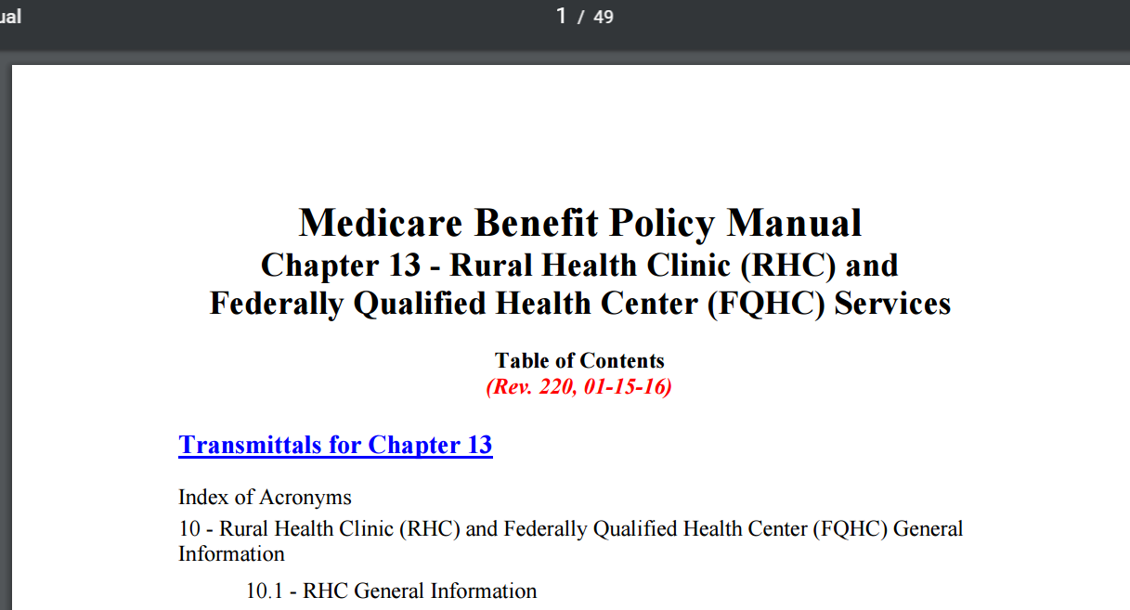
Once you know documentation and coding….
38 pages of gov’t regulations
49
pages of gov’t regulations
Be sure to get the most recent versions – they may have been updated!

Slide 10
The type of insurance impacts billing – but NOT coding and quality of care!
Where Medicare goes with billing rules and regulations – who follows?
Medicaid leans heavily towards Medicare but often has their own rules – for example, the use of T-codes like T1001 for Nurse Assessment. Be knowledgeable of their guidelines and how they distribute updates!
Payment issues and billing rules are affected in terms of frequency, covered diagnoses, and covered services.
As far as private/commercial payers (e.g. Aetna, BCBS, employer plans) everything is based on your participation agreement/contract – we don’t have access to these and can’t get specific in class!
Should we expect there is a difference in billing rules even within a private payer based on the “entry-level” versus the “platinum” plans?
Medicare/Medicaid Advantage need to be grouped under the broad category of “commercial” payers since they are not “pure Medicare” and have inherent differences.

Slide 11
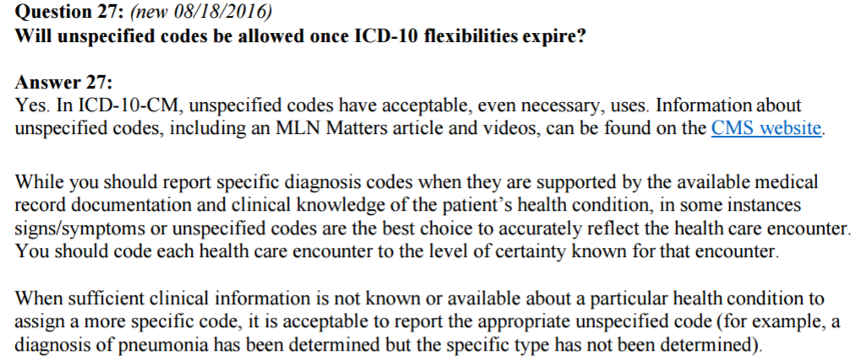
SOURCE: Clarifying Questions and Answers Related to the July 6, 2015, CMS/AMA Joint Announcement and Guidance Regarding ICD-10 Flexibilities – ADDED information to FAQs 8-18-16
SOURCE: https://www.cms.gov/Medicare/Coding/ICD10/Clarifying-Questions-and-Answers-Related-to-the-July-6-2015-CMS-AMA-Joint-Announcement.pdf

Slide 12
Some of the main Z-Codes in ICD-10-CM Impacting Rural Health
Z-codes can be primary or secondary depending on the procedure/service provided; however, some “may only be used as first-listed or (as a) principle diagnosis.”
Z00.0- replaces V70.0 - Encounters for general adult medical examination (with or without abnormal findings) NOTE: “The codes are not to be used if the examination is for diagnosis of a suspected medical condition or for treatment purposes”
Z00.1– replaces V20.- Encounters for health exam of newborns and routine children (with or without abnormal findings) NOTE: “Pre-existing and chronic conditions and history codes may also be included as additional codes as long as the exam is for administrative purposes and not focused on any particular condition”
Z01.41- replaces V72.31 – Encounters for annual GYN exam (with or without abnormal findings) NOTE: If “the encounter is being coded before test results are back, it is acceptable to assign the code for ‘without abnormal findings’”
QUESTION – Where are the notes in red found in the ICD-10-CM software or EHRs? Or are they elsewhere?

Slide 13
Interesting Z-code info…
ICD-9 Codes and Definitions | ICD-10 Codes and Definitions | NOTES
V03 – V06 Encounters for numerous specified vaccination | Z23 – Encounter for Vaccination (one code does it all!) | “Code first any routine childhood examination” + “Procedure codes are required to identify the types of immunizations given”
n/a | Review codes from Base Code section Z28 for Immunizations not carried out and under-immunization status- the reason changes the codes | Note options for “due to acute/chronic illness” and religious or caregiver decision
V25.49 - Surveillance of other contraceptive method | Z30.42 – Encounter for surveillance of injectable contraceptives Z30.49 – Encounter for surveillance of other contraceptives | Be aware that there are other options in this section (Z30) for example Z30.41 – Encounter for surveillance contraceptive pills, and Z30.431 for IUD, and more

Slide 14
Other interesting Z-code info…
ICD-9 Codes and Definitions | ICD-10 Codes and Definitions | NOTES
V73.89 - Special screening examination for other specified viral diseases | Z11.4 – Encounter for HIV Z11.59 – Encounter for other viral disease | Use additional code (Z11.0)if screening for viral intestinal disease
V74.5 – Screening exam for venereal disease | Z11.3 – Encounter for screening for infections with a predominately sexual mode of transmission – NOTE: Review the base code + Exclude 2 notes in the manual! | V74.5 is for venereal disease screening and the ICD-9 has codes for screening for HPV, chlamydia as well that map to other new ICD-10 codes (Z.11 has several code options use caution!)
V81.1 – Screening for hypertension | Z13.6 – Encounter for screening for cardiovascular disorders | This should only be used for an asymptomatic patient from a coding perspective. Code the signs/symptoms if documented.

Slide 15
GENERAL INFO – ICD-10-CM Official Guidelines for Coding & Reporting

Slide 16
Assumptions and Prerequisites
You know how to navigate the physical ICD-10 manuals – specifically Volume 1 (Tabular List) & Volume 2 (Alphabetic Index) and each section’s content
Guidelines
Table of Drugs/Chemicals
You have performed hands-on testing on how to use your IT tools such as your EHR’s code look-up features, software encoders, and other IT short cuts, etc. and fully understand their limitations.
You are aware of GEMS/Crosswalks/Mappers and the inherent compliance danger of relying on them to code/bill for you based solely on what you coded in ICD-9-CM

Slide 17
Official ICD-10 Guidelines Review
The Official Guidelines are broken down in to sections:
Section I: A. Conventions of ICD-10
Conventions of ICD-10-CM
Alphabetic Indexing and Tabular Listings
Format and Structure
Use of Codes for Reporting Purposes
Placeholder Character
7th Digit Characters
Abbreviations (Index and Tabular)
Punctuation
Use of “And”, “With”, “See Also”, “Code Also”
“Unspecified” Codes, “Includes” and “Excludes”
Etiology/Manifestation Conventions (e.g., “code first”, “use additional code”, “in diseases classified elsewhere”
Default codes and Syndromes

Slide 18
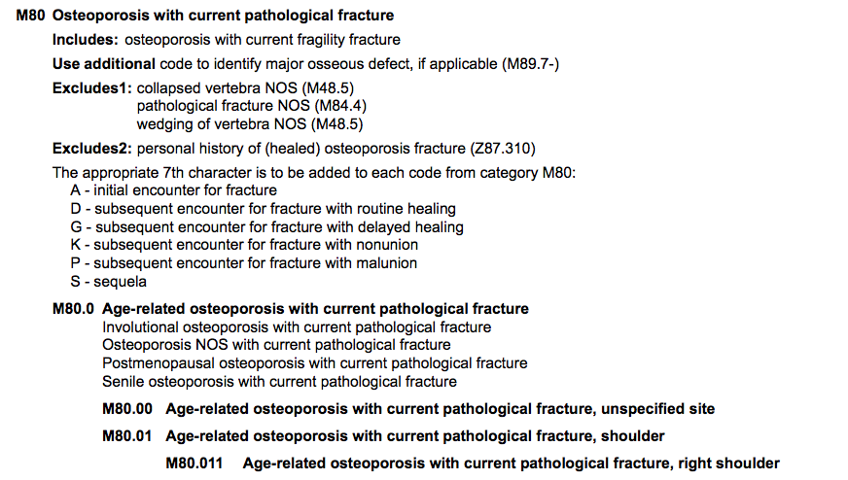
ICD-10-CM –7th Characters
The 7th Character in ICD-10-CM

Slide 19
Official ICD-10 Guidelines Review
Section I: B. General Coding Guidelines
Locating ICD-10 codes, levels of detail in coding
Codes A00.0-T88.9, Z00-Z99.8
Signs and Symptoms
Conditions that are integral part of disease process
Conditions that are not integral part of disease process
Multiple coding for a single condition
Acute and Chronic conditions
Combination codes
Late effects (sequela)
Impending or threatened conditions
Reporting same diagnostic code more than once
Laterality
Documentation for BMI and Pressure Ulcer stages

Slide 20
How To Locate An ICD-10-CM Code
To properly select a code in the classification that corresponds to a diagnosis or reason for the patient encounter…
First, locate the term in the Alphabetic Index – carefully follow indentations and “see also” items – it is not always a straightforward journey – some IT tools can lead you down the wrong path!
Next, verify the code in the Tabular List – review the base code(s)
Always consult the instructional notations that appear in both the Index and the Tabular List

Slide 21
Code Structure: ICD-10-CM
1st - Alpha
(Except U)
2nd Numeric
3 - 7 Numeric or Alpha
.
.
X
X
X
X
A
A
M
V
X
9
X
1
0
7
X
X
“Base code”
CMS calls this a
“Family” of Codes
But it can extend
to the 4th-5th digit as well!
Watch for
explanatory
notes!
Added code extensions (7th character) for obstetrics, injuries, and external causes of injury
Watch for the “dummy”
placeholder in the 5th and/or 6th
character position

Slide 22
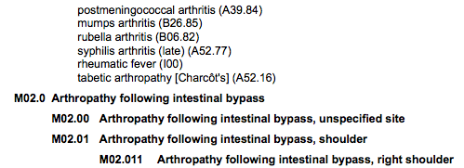
ICD-10-CM – “Base Codes” are KEY!
Similarities Example - M02

Slide 23
Section I: C. Chapter Specific Coding Guidelines
Chapter 1: Infectious and Parasitic Disease (A00-B99)
Chapter 2: Neoplasms (C00-D49)
Chapter 3: Diseases of Blood and Blood Forming Organs (D50-D89)
Chapter 4: Endocrine, Nutritional and Metabolic Diseases (E00-E89)
Diabetes is located in this section (E08-E13)
Chapter 5: Mental and Behavioral Disorders (F01-F99)
Chapter 6: Diseases of the Nervous System and Sense Organs (G00-G99)
Chapter 7: Diseases of the Eye and Adnexa (H00-H59)
Chapter 8: Diseases of the Ear and Mastoid Process (H60-H95)
Chapter 9: Disease of the Circulatory System (I00-I99)
Hypertension is located in this section (I10-I15), R03.0 for elevated BP (ICD-9 code 796.2)
Chapter 10: Diseases of the Respiratory System (J00-J99)
Chapter 11: Diseases of the Digestive System (K00-K94)
Chapter 12: Diseases of Skin and Subcutaneous Tissue (L00-L99)
Chapter 13: Diseases of the Musculoskeletal System and Connective Tissue (M00-M99)

Slide 24
Section I: C. Chapter Specific Coding Guidelines
Chapter 14: Diseases of the Genitourinary System (N00-N99)
Chapter 15: Pregnancy, Childbirth, Pueperium (O00-O9A)
OB, Delivery and Postpartum Services
Chapter 16: Newborn (Perinatal) Guidelines (P00-P96)
Newborn services and reporting stillborns
Chapter 17: Congenital Malformations, Deformations, and Chromosomal Abnormalities (Q00-Q99)
Chapter 18: Symptoms, Signs, and Abnormal Clinical and Laboratory Findings, Not Elsewhere Classified (R00-R99)
Codes that describe symptoms and signs are acceptable for reporting purposes when a related definitive diagnosis has not been established (confirmed) by the provider.
Chapter 19: Injury, Poisoning and Certain Other Consequences of External Causes (S00-T88)
Chapter 20: External Causes of Morbidity (V01-Y99)
Chapter 21: Factors Influencing Health Status and Contact With Health Services (Z00-Z99)

Slide 25
What I Learned from the ICD-10 Implementation
Coding is a process that requires high-level critical analysis skills
Team-based Training works the best – especially considering workflow changes brought by EHRs
Many believe that there is an IT solution to documentation>coding>billing – it is simply not true
I had the chance to see several EHR systems, encoders, and other applications that NEVER gave the same detailed information as an actual ICD-10-CM manual
The Official Guidelines for Coding and Reporting provided the best educational moments.
There is no way to memorize your most relevant ICD-10 codes, nor will the traditional concept of a superbill/encounter form capture the variety of diagnoses we see.

Slide 26
Main ICD-10-CM References
History of the development of the ICD, World Health Organization website, http://www.who.int/classifications/icd/en/
ICD-10-CM Official Guidelines for Coding and Reporting-2017, Centers for Disease Control (CDC), National Center for Health Statistics
http://www.cdc.gov/nchs/icd/icd10cm.htm
Centers for Medicare & Medicaid Services ICD-10 page:
http://www.cms.gov/Medicare/Coding/ICD10/index.html?redirect=/ICD10
Assorted guidelines and concepts created and/or approved by the official ICD-10 Cooperating Parties:
American Hospital Association (AHA),
American Health Information Management Association (AHIMA),
Centers for Medicare and Medicaid Services (CMS), and
National Center of Health Statistics (NCHS)

Slide 27
2018 UPDATES – ICD-10-CM Official Guidelines for Coding & Reporting

Slide 28
Key updates to the 2018 Guidelines
Please be sure to download the 117 page guidelines from the Handouts section in the webinar chat room or from tis website: https://www.cms.gov/Medicare/Coding/ICD10/Downloads/2018-ICD-10-CM-Coding-Guidelines.pdf

Slide 29
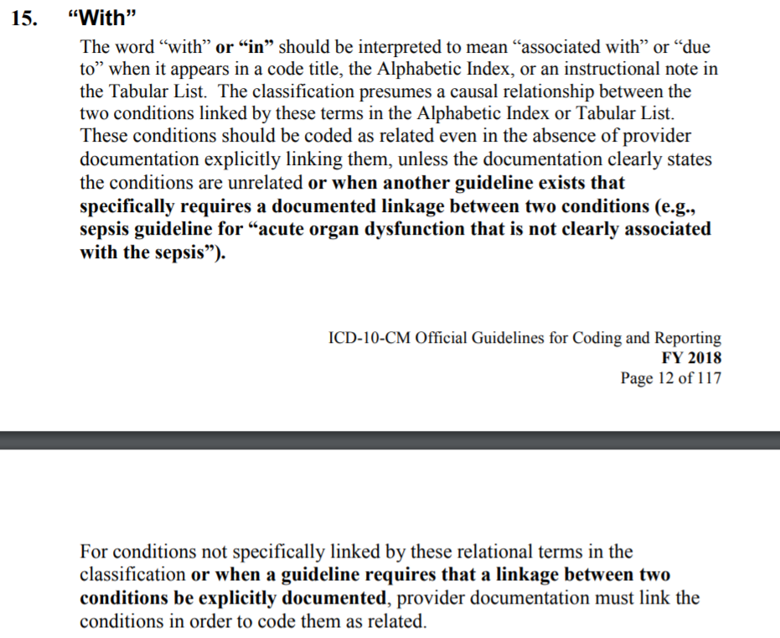
Clarity on use of the word “with” in ICD-10-CM code definitions

Slide 30
Clarity on the proper sequencing of ICD-10 codes
(Page 13)

Slide 31
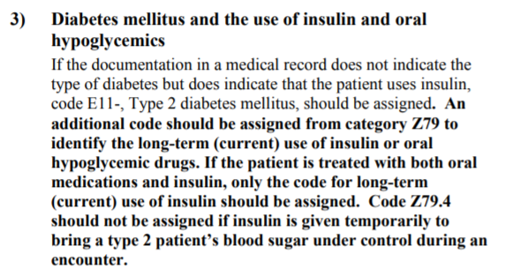
Using add-on diagnoses for Diabetes in Section B – Chapter 4

Slide 32
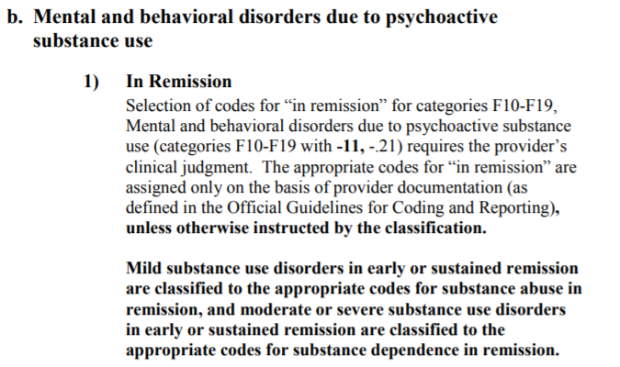
Clarity on Remission Coding related to Substance “Use” versus “Dependence”

Slide 33
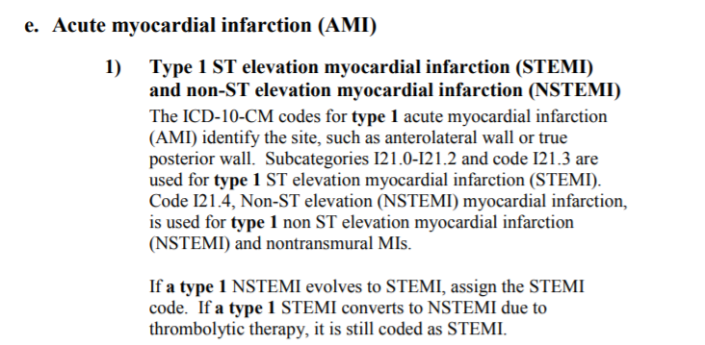
A lot of changes to coding of Myocardial Infarctions – work with your referring docs and read the full section in this applies!

Slide 34
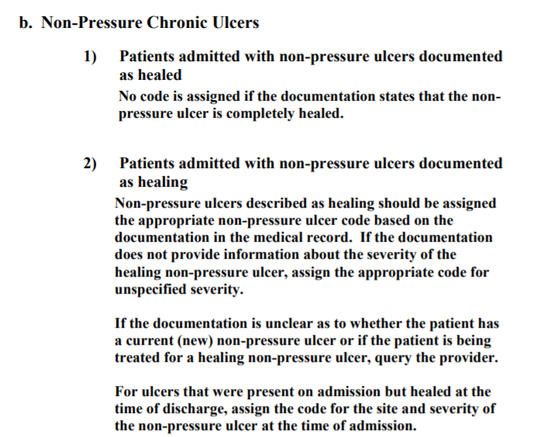
Work in a small Rural hospital that owns RHCs?

Slide 35
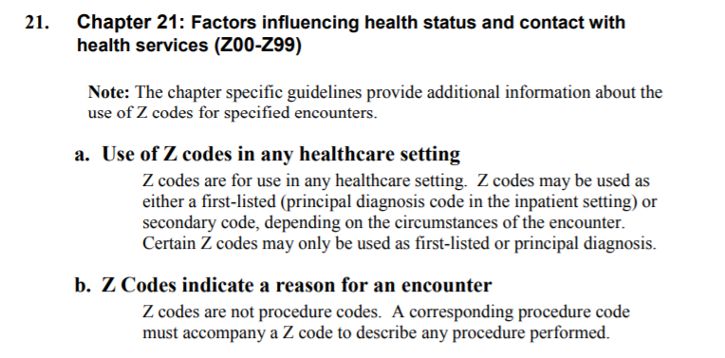
Though there are no significant 2018 updates in Section C for Chapter 21: Z-codes – you should give it a read since they are so common in Rural Health

Slide 36
More Z-Code Info for Rural Health Clinics

Slide 37
V-codes essentially became Z-codes in ICD-10-CM
Chapter 21: Factors Influencing Health Status and Contact with Health services (Z00-Z99)
Changes
Reclassification of aftercare codes
More specificity of categories
Most mappings are 1:1 – with minor documentation changes but some require further analysis, documentation, and careful code selection
This is one chapter that you may literally need to review EVERY CODE individually to see if it fits your organization’s needs!

Slide 38
Additional Z-Codes in ICD-10-CM
Z01.20 and .21 - Encounters for dental exam and cleaning (with or without abnormal findings)
Please review the entire Base Code section for Z01.8- for Encounters for pre-procedural exams for cardio, respiratory, lab, allergy, blood typing, antibody responses
Please review the entire Base Code section for Z02 - Z04 for Encounters for administrative exams
Z02.5 – Sports physicals
Z02.71 – Disability exams
Z04.71 and Z04.72 – Exams foll0wing alleged adult or child abuse

Slide 39
Some More Z-Codes
Please review the entire Base Code section for Z30 for contraceptive management –
Codes identify Initial prescriptions + ongoing Surveillance
Options for different types of contraceptives including options for pills vs. injectable vs. IUDs
Please review the entire Base Code section for Z48 for Encounters for post-procedural aftercare
Z48.00 – Change or removal of nonsurgical wound dressing
Z48.01 – Change or removal of surgical wound dressing
Z48.02– Encounter for removal of sutures
Please review the entire Base Code section for Z53 for Cancelled procedures for various reasons

Slide 40
Please review the entire Base Code section for Z72 for Problems Related to Lifestyle
Z72.0 – Tobacco use – See the important Excludes1 notes!!!
Z72.3 – Lack of exercise
Z72.4 – Inappropriate diet and eating habits
Z73 – some interesting and semi-funny codes…
Z76.0 – Encounter for issue of repeat prescription
Z79 – Pleas review this entire section for Long-term (current) drug therapies including: anti-coagulants, anti-thrombics, NSAIDs, hormonal contraceptives, insulin, steroids
“Code also any therapeutic drug level monitoring (Z51.81)”

Slide 41
Other interesting Z-code info…
ICD-9 Codes and Definitions | ICD-10 Codes and Definitions | NOTES
V20.2 - Routine infant or child health check | Z00.121 – Encounter for routine child health examination with abnormal findings Z00.129 – Encounter for routine child health examination without abnormal findings | See also ICD-9 codes V20.0, V20.1, V20.31, and V20.32 that map to ICD-10 codes Z76.1 and V76.2 as possible other options. These codes are NOT for children under 28 days old – see Excludes1 notes!
V23.9 - Supervision of unspecified high-risk pregnancy | O09.90 through O09.93 – to determine last digit you must identify the trimester e.g. unspecified, 1st, 2nd, 3rd trimester | Note that there are several codes for supervising a high-risk pregnancy in the ICD-9 V23.8-; therefore use caution with a generalized diagnosis if more detailed codes are documented. See also the entire O09 section that has other code options.

Slide 42
Other interesting Z-code info…
ICD-9 Codes and Definitions | ICD-10 Codes and Definitions | NOTES
V72.31 – Routine GYN exam | Z01.411 – Encounter for GYN (exam)(routine) with abnormal findings | Results found in exam and/or labs influences code choice. Carefully review notes under Z01.4 section.
“ | Z01.419 – Encounter for GYN (exam)(routine) without abnormal findings
V72.32 - Encounter for Papanicolaou cervical smear to confirm findings of recent normal smear following initial abnormal smear | Z01.42 - Encounter for Papanicolaou cervical smear to confirm findings of recent normal smear following initial abnormal smear | Note that this diagnoses does not reference a follow-up GYN exam, rather a follow up Pap smear
V72.40 - Pregnancy examination or test, pregnancy unconfirmed | Z32.00 – Encounter for pregnancy test, results unknown | Also link V72.41 and .42 to Z32.01 and .02 depending on results of pregnancy test

Slide 43
Thank You!

