Slide 1
HIPAA Compliance for the RHC
Presented by Sarah Badahman
CEO/Founder, HIPAAtrek
www.hipaatrek.com
sarah@hipaatrek.com
314-272-2600
Created for HSA

Slide 2
What is HIPAA?
Regulations guiding the privacy and security of Protected Health Information
Intentionally created to flexible to meet the unique culture of organizations of all sizes
State rules may be more stringent than HIPAA and therefore supersede the federal requirements

Slide 3
Important Terms
Protected Health Information (PHI)
A set of 18 individually identifiable health information that could be used to identify a patient
Standard
These are the safeguards that HIPAA expects to be in place
Implementation Specification
These are the steps needed to achieve the requirements of a given standard
Required
All standards are required
Some implementation specifications are required, meaning you must implement those standards
Addressable
Addressable does not mean optional. You must perform an assessment to determine if the implementation specification is appropriate and reasonable for your organization
Covered Entity
Health plans, clearinghouses, and providers which electronically transmit or receive any protected health information
Business Associate
Any organization or person working in an association with or providing services to a covered entity who handles or discloses Protected Health Information or Personal Health Records

Slide 4
Protected Health Information (PHI)
1. Names 2. All geographical subdivisions smaller than a State*
3. All elements of dates (except year) for dates directly related to
an individual*
4. Phone numbers
5. Fax numbers
6. Electronic mail addresses
7. Social Security numbers
8. Medical record numbers
9. Health plan beneficiary numbers
10. Account numbers
11. Certificate/license numbers
12. Vehicle identifiers and serial numbers, including license plate
numbers
13. Device identifiers and serial numbers
14. Web Universal Resource Locators (URLs)
15. Internet Protocol (IP) address numbers
16. Biometric identifiers, including finger and voice prints
17. Full face photographic images and any comparable images; and any other unique identifying number, characteristic, or code*
18. Other – any other uniquely identifying characteristic, code, or identifier
(* = Additional information applies

Slide 5
What Does HIPAA Want From Me?!
Privacy Rule Objectives: Addresses all forms of Protected Health Information – Paper, Electronic, Oral. Safeguards must be implemented to prevent uses and disclosures of a patient’s protected health information without the patient’s authorization or express authorization within the Rule itself. There are instances in which the patient’s permission is not required.
Security Rule Objectives: Applies only to electronic forms of Protected Health Information. The primary goal is to protect the privacy of individuals’ health information while allowing covered entities to adopt new technologies to improve the quality and efficiency of patient care. Given that the health care marketplace is diverse, the Security Rule is designed to be flexible and scalable so a covered entity can implement policies, procedures, and technologies that are appropriate for the entity’s particular size, organizational structure, and risks to consumers’ e-PHI.
Breach Notification Objectives: Requires covered entities and their business associates to report breaches in privacy or security due to unprotected health information.

Slide 6
Arming your Staff for Success
Written Policies and Procedures: These policies should be accessible to providers and staff so that questions about business processes can be easily answered. Those policies might include:
Registration and Front Desk Processes
Content of the Medical Record
Privacy and Security
Employee Training, Training Records, and Acknowledgments
Release of Information Procedures
Internal Audit Processes
External Audit Processes
Storage, Retention and Disposition of Health Information (PHI)
Storage, Retention and Disposition of Business Records
Staff Education: An organization should train providers and staff on policies and procedures at hire and at least annually thereafter. Inter-periodic training may be needed to reteach whenever questions, incidents or weaknesses are detected.

Slide 7
What is Minimum Necessary Access
Legalese: §164.502(b)(1) When using or disclosing protected health information or when requesting protected health information from another covered entity or business associate, a covered entity or business associate must make reasonable efforts to limit protected health information to the minimum necessary to accomplish the intended purpose of the use, disclosure, or request.
What does this mean to me??
Never share PHI with any person or entity who does not have a Treatment, Payment or Operations (TPO) need for the PHI without an authorization from the patient
Limit employee access to PHI to employees to only the PHI necessary to do their jobs
If you inadvertently receive PHI that is not required for your job, report it immediately to your supervisor or HIPAA Compliance Officer – this should be treated as a Privacy Breach

Slide 8
Disclosures
Incidental Disclosure:
An incidental use or disclosure is a secondary use or disclosure that cannot reasonably be prevented, is limited in nature, and that occurs as a result of another use or disclosure that is permitted by the Rule. However, an incidental use or disclosure is not permitted if it is a by-product of an underlying use or disclosure which violates the Privacy Rule.

Slide 9
Disclosures
Healthcare Operations Disclosures:
Conducting quality assessment and improvement activities
Patient safety activities
Protocol development
Case management
Reviewing the competence or qualifications of healthcare professionals
Training programs
Accreditation, certification, licensing, or credentialing activities
Fraud and abuse detection and compliance programs
Conducting or arranging for medical review
Business planning and development

Slide 10
Secure communication
Receiving PHI
Ensure your email, fax, or other electronic communications are secure
Do NOT use free email accounts – they are not secure
Verify you have a TPO reason to receive the PHI
Notify the sender immediately if you receive PHI you should not have and follow their instructions on destroying the PHI
Transmitting PHI
Encrypted Email
Secure Fax with cover sheet
Mail
Other secure mechanisms
Storing PHI
Only store required PHI onto hard drives
Ensure its stored on secure drives or workstations
Notes:
Sarah – data and communication

Slide 11
What constitutes a breach…
A breach is, generally, an impermissible use or disclosure under the Privacy Rule that compromises the security or privacy of the protected health information. An impermissible use or disclosure of protected health information is presumed to be a breach unless the covered entity or business associate, as applicable, demonstrates that there is a low probability that the protected health information has been compromised based on a risk assessment of at least the following factors:
The nature and extent of the protected health information involved, including the types of identifiers and the likelihood of re-identification;
The unauthorized person who used the protected health information or to whom the disclosure was made;
Whether the protected health information was actually acquired or viewed; and
The extent to which the risk to the protected health information has been mitigated

Slide 12
One third of all breaches are caused by third parties – not the healthcare entity

Slide 13
Why is it Important to Manage Business Associate Relationships
Security and Privacy
Breach Prevention / Management
Compliance with the Privacy and Security Rules
Management of Business Associate Terms & Conditions
A healthy organization is a compliant organization

Slide 14
What is a Business Associate
“A ‘business associate’ is a person or entity that performs certain functions or activities that involve the use or disclosure of protected health information on behalf of, or provides services to, a covered entity. A member of the covered entity's workforce is not a business associate.”

Slide 15
What is a Business Associate
Business associate functions and activities include
Business associate services are
Claims processing or administration
Data analysis, processing or administration
Utilization review
Quality assurance
Billing
Benefit management
Practice management
Legal
Actuarial
Accounting
Consulting
Data aggregation
Management
Administrative
Accreditation
Financial

Slide 16
Is Protected Health Information (PHI) being disclosed to a person or entity other than in the capacity as a member of the covered entity’s workforce?
yes
no
Is the PHI being disclosed to a healthcare provider for treatment purposes (primary care provider, dentist, rehab or nursing staff, ambulance…)?
no
yes
Is the PHI being disclosed to a health plan for payment purposes, or to a health sponsor with respect to disclosures by a group health plan?
yes
no
Is the PHI being disclosed to a government agency pursuant to an official investigation (CMS, OCR, OSHA, FDA, Health Department, etc…)?
BA Agreement IS Needed
yes
BA Agreement is NOT Needed
no
Is the PHI being disclosed to another covered entity that is part of an organized healthcare arrangement in which the originating covered entity participates?
yes
no
yes
Does the other person or entity create, receive, maintain, or transmit PHI for a function or activity regulated by HIPAA: claims processing, data analysis, utilization review, quality assurance, patient safety activities, billing, benefits management, practice management…)?
no
yes
Does the person or entity provide legal, actuarial, accounting, consulting, or other services where the provision of such services involves disclosure of PHI to the person or entity?
no
yes
Will the other person or entity be able to access PHI on a routine basis AND/OR is there a possibility that the PHI in the person or entity’s control could be compromised (data storage, shredding company…)?
no

Slide 17
Why Audit Your Business Associates
You are responsible to ensure you are using compliant vendors
Compliance with the Business Associate Agreements
Security and Privacy is MORE than just compliance
Business Associates – Independent Contractor vs. Agent Rule

Slide 18
How to Audit your Business Associates
Ask to see their policies
Data Backup
Secure Communication
Data Destruction
Ask to see proof of implementation
Send out a survey with questions on how they are handling your PHI

Slide 19
internal processes are more than just your policies

Slide 20
Time Limit
Time Limit
Legalese: “Retain the documentation required by paragraph (b)(1) of this section for 6 years from the date of its creation or the date when it last was in effect, whichever is later.”
There may be other laws within the state that require retention of documentation for longer periods. Seek legal counsel for specifics.
Version control management
Be sure to notate when the policy was first created
Be sure to notate when the policy is updated
Maintain each new version for the time limit required by law

Slide 21
Availability
Legalese: “Make documentation available to those persons responsible for implementing the procedures to which the documentation pertains.”
Consider:
Having printed manuals for your management and staff
Posting your policies and procedures on your intranet
Using a software management system to manage and share your policies and procedures

Slide 22
Updates
Legalese: “Review documentation periodically, and update as needed, in response to environmental or operational changes affecting the security of the electronic protected health information.”
Considerations:
Frequency of reviews
Operational Changes
Move to EMR
Change EMR
Physical location
Identified threats in risk analysis
Major staffing changes

Slide 23
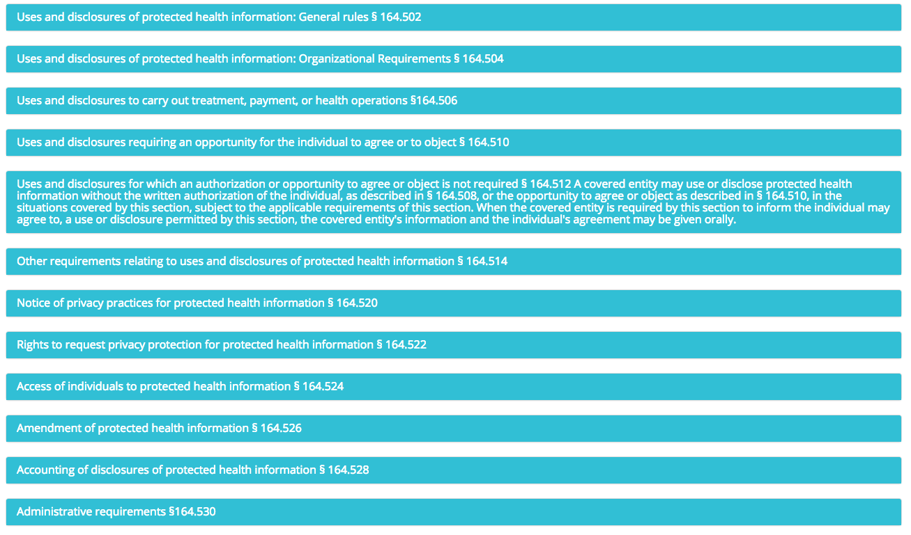
Privacy Rule

Slide 24
Security Rule Requirements
Administrative Safeguards (23 Implementation Specifications)
Security Management Process
Assigned Security Responsibility
Physical Safeguards (10 Implementation Specifications)
Facility Access Controls
Workstation Security
Technical Safeguards (9 Implementation Specifications)
Access Controls
Audit Controls
Workforce Security
Information Access Management
Security Awareness and Training
Security Incident Procedures
Contingency Plan
Evaluation
Business Associate Agreements and Other Arrangements
Workstation Use
Device and Media Controls
Integrity
Person or Entity Authentication
Transmission Security

Slide 25
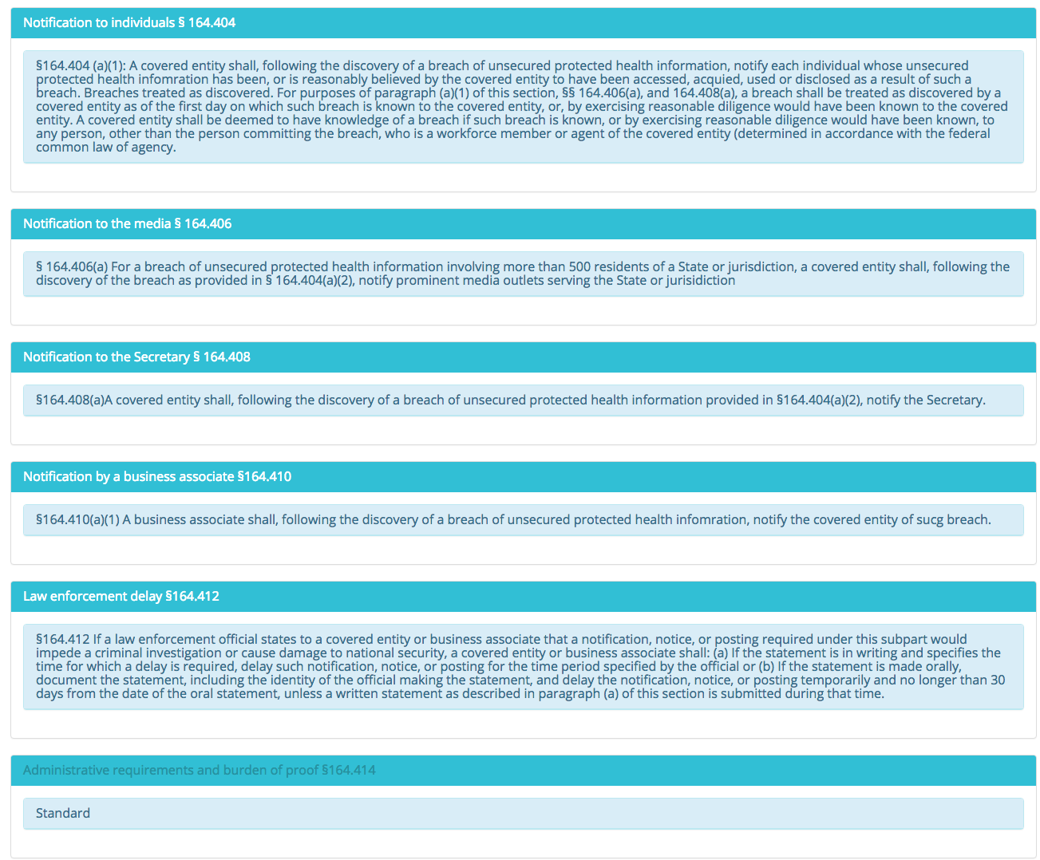
Breach Notification Rule

Slide 26
Create An Auditable Trail of Compliance
Document every compliance activity
Who, when, why, how of every activity

Slide 27
Create a culture of Security over Compliance
Focus on security and compliance will follow
Notes:
Sarah – data and communication

Slide 28
Beyond workforce member and client errors – data security remains lax

Slide 29
Why are We Being Attacked
The Weakest Link
72% increase in healthcare attacks since 2013
Hackers exploit the fact that healthcare professionals are nurturers and caregivers by nature
Technology has grown faster than security measures
REMEMBER: Business Associates are responsible for 1/3 of all breaches!
Health Information on the Black Market
Worth 10x more than credit card information
Average of $363 per healthcare record
Notes:
Predators go after the weakest link
72% increase in healthcare attacks since 2013
Protected Health Information is worth 10x credit card information on the black market
Average of $363 per healthcare record
Up to $20 per financial or credit card record
Hackers exploit the fact that healthcare professionals are nurtures and caregivers by nature – we want to help
Adoption of technology in healthcare has grown at a higher rate than the adoption of security measures

Slide 30
Paper Records
Clean Desk Clear Screen policy
Disposal of Paper
Only print what is necessary
Secure storage of paper records

Slide 31
Electronic Records
Access of electronic records
User ID and Password Management
Altering electronic records
Disposal of records
Audit logs

Slide 32
Encryption
Full Disk Encryption
File level encryption
Laptop security and encryption
Encryption and mobile devices

Slide 33
Workflow Safeguards
Automatic logoff
Bring your own device policy
Facility security

Slide 34
HIPAA Compliance – a changing environment

Slide 35
Proactive vs Reactive Regulatory Environment
Office for Civil Rights (OCR) is conducting audits
2016 audits of Covered Entities
2017 audits of Business Associates
If chosen for an audit, you have 10 days to respond – don’t delay!
Never submit more than what is requested to an auditor

Slide 36
sarah@hipaatrek.com
314-272-2600
Questions?
?
?
?
?
?
?
?
?

