Slide 1
Washington Update Georgia Rural Health Association
Nathan Baugh
Director, Government Relations
(202) 544-1880
Baughn@capitolassociates.org
www.narhc.org

Slide 2
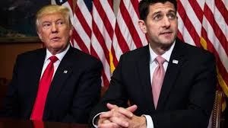
Overview
NARHC Political Update
New Rules
2018 PFS Rule
2018 QPP Rule

Slide 3
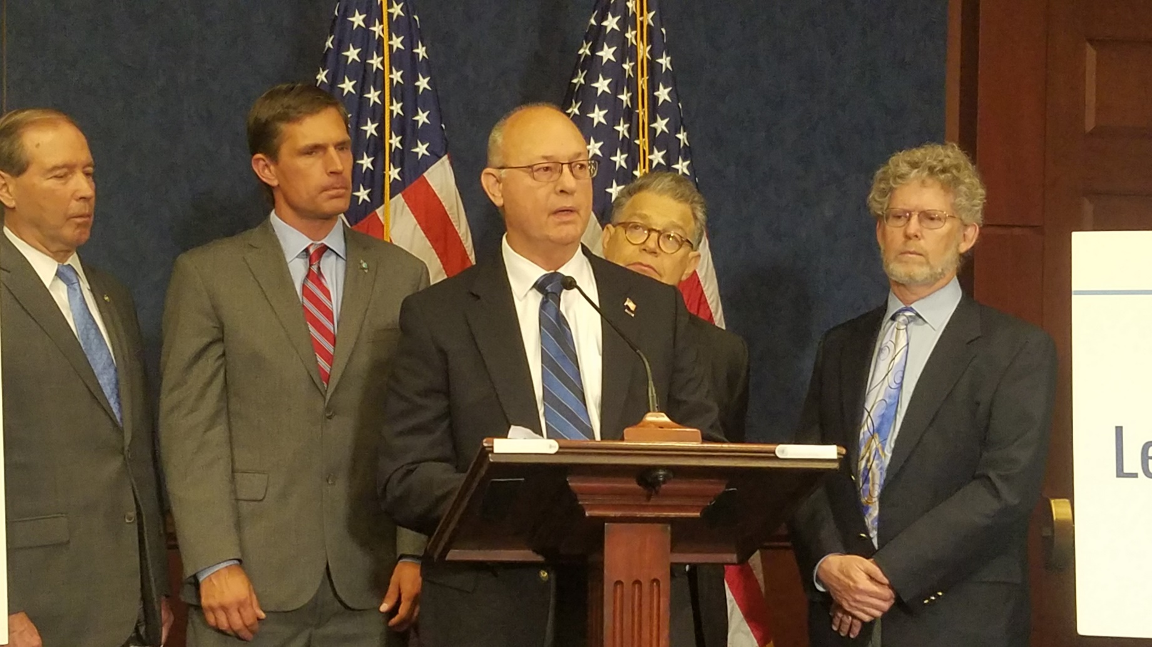

Slide 4
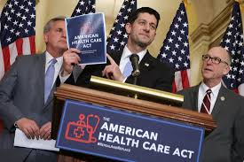
Healthcare Reform Where are we?
Legislation stalled out in the Senate
If tax reform passes, they may try again in early 2018
Legislative vehicles for healthcare changes: Debt ceiling/Budget/Appropriations
Executive Order healthcare reform
Medicare-focused bill this Congress?

Slide 5
Republican Healthcare Reform What does it do?
Repealed aspects of the Affordable Care Act related to taxing and spending
Replaced ACA subsidies with tax credits (varying amounts ~ winners and losers)
Sunset Medicaid expansion enhanced FMAP rate – what will states do in response?
Promotes the creation of low premium high deductible plans with health savings accounts (HSAs)
Placed State Medicaid Programs on a Per-capita budget.

Slide 6
Healthcare Reform Why do RHCs care?
Per-capita allotment gives states a strong incentive to stay under budget
Federal government savings could shift costs onto states but could also force states to innovate their Medicaid programs
Would states feel a budget squeeze and seek to reduce RHC Medicaid payments?
Federal mandate establishes the Medicaid payment rate for RHCs

Slide 7
Federal Medicaid spending under ACA vs AHCA
Calculations from data collected by:
https://www.cms.gov/Research-Statistics-Data-and-Systems/Research/ActuarialStudies/Downloads/MedicaidReport2016.pdf
https://www.cbo.gov/sites/default/files/115th-congress-2017-2018/costestimate/americanhealthcareact.pdf

Slide 8
Year | Projected Federal Medicaid Expenditure under ACA (billions) | Projected Federal Medicaid Expenditure under AHCA (billions) | Percent difference in projected spending between ACA and AHCA
2017 | 368.9 | ** | **
2018 | 392.5 | 378.5 | 3.57%
2019 | 415.3 | 389.3 | 6.26%
2020 | 439 | 374 | 14.81%
2021 | 465.3 | 376.3 | 19.13%
2022 | 492.2 | 387.2 | 21.33%
2023 | 521.6 | 404.6 | 22.43%
2024 | 553.4 | 424.4 | 23.3%
2025 | 587.6 | 448.6 | 23.65%
Calculations from data collected by:
https://www.cms.gov/Research-Statistics-Data-and-Systems/Research/ActuarialStudies/Downloads/MedicaidReport2016.pdf
https://www.cbo.gov/system/files/115th-congress-2017-2018/costestimate/hr1628aspassed.pdf

Slide 9
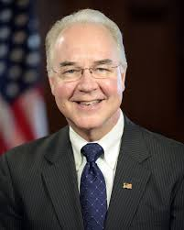
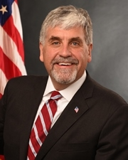
Healthcare Reform Trump Administration Policy
With healthcare reform stalled regulatory actions become more significant
What will Acting Secretary Eric Hargan, nominee Alex Azar and Seema Verma do?
Over 900 instances of the phrase “Secretary shall” in ACA
Will they want people to sign up on healthcare.gov during the enrollment period?
Advertising cut
Will they enforce ACA tax penalties/mandates?
Individual mandate repeal in Senate Tax bill
Will they continue Cost-Sharing Reduction (CSR) payments?
No ~ repealed
Medicaid and ACA waivers

Slide 10
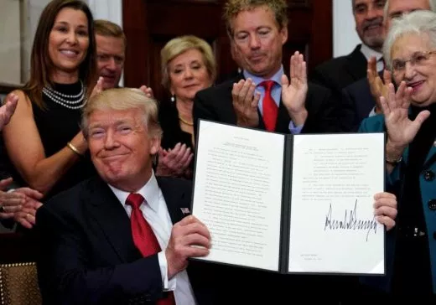
Trump Executive Order “Promoting Healthcare Choice and Competition Across the United States”
President Trump signed this order on Oct. 13
Order directs his Administration to do three things:
Expand Access to Association Health Plans
Goal is to create more access to the stable/cheap “large group” market
Expands Short-Term, Limited Duration Insurance (STLDI)
This was short term (3 month insurance) for transitional periods
Not subject to ACA rules
Directs agency to allow people to have “temporary” insurance longer
Expands availability of Health Reimbursement Arrangements (HRAs)
Similar to HSAs
Another tool to finance healthcare

Slide 11
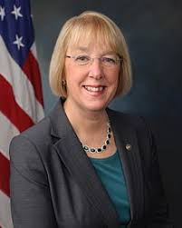
Bipartisan Legislation?
Senators Lamar Alexander (R-TN) and Patty Murray (D-WA) have agreed to a short term ACA stabilization bill
Unclear if McConnell, House of Representatives or Trump would support ~ reports that Sen. Collins received assurances that this bill would be included in appropriations package for her vote on tax reform
What does it do?
Funds CSRs through 2019
Streamlines ACA waiver process allowing for reinsurance programs
Allows all consumers (not just under 30) to buy “Copper” plans
Funds advertising for exchange plans
Directs HHS to issue additional rules for interstate compacts
Does bolstering the current market reduce pressure for repeal/replace?

Slide 12
2018 PFS Proposed Rule (Regulatory)
CMS is proposing to expand the care management benefit for RHCs.
Currently RHCs can only bill for the basic CCM code (99490) which pays $42.71
Starting next year this code will be GCCC1 and the payment will be approx. $61.37
GCCC1 is billable if you have provided 99490, 99487 (complex CCM), or G0507 (20 minutes or more of general behavioral health integration services)
Also adding GCCC2 (payment of approx. $126.33)
GCCC2 is billable for G0502 (70 minutes of initial psychiatric CoCM) or G0503 (60 minutes of subsequent psychiatric CoCM)
CMS webinar on these new care management benefits: https://www.cms.gov/Outreach-and-Education/Outreach/NPC/National-Provider-Calls-and-Events-Items/2017-08-01-CCM-Call-Archived.html?DLPage=1&DLEntries=10&DLFilter=care%20manage&DLSort=0&DLSortDir=descending
ACO attribution will no longer require attestation. Any RHC service would qualify the patient as eligible for assignment to an ACO

Slide 13
2018 Proposed QPP Rule (MACRA)
MACRA = Medicare Access and CHIP Re-authorization Act (law)
QPP = Quality Payment Program which is the all encompassing term for both:
MIPS (Merit-based Incentive Payment System) and;
APM (Alternative Payment Models)
CMS has proposed that the low-volume threshold be greatly increased in 2018
$90,000 part B allowable revenue or 200 Medicare part B patients
Up from $30,000 and 100 part B patients
RHC AIR is not affected by QPP
Clinicians can report individually, or a group, or as a virtual group to participate in or exempt themselves from QPP as they see fit
Quality is coming almost certainly but NARHC has concerns about “false starts”
How and when “quality” comes to the RHC program is unclear

Slide 14
Emergency Preparedness Links/More Information
SCGEmergencyPrep@cms.hhs.gov
https://www.cms.gov/medicare/provider-enrollment-and-certification/surveycertemergprep/emergency-prep-rule.html
Above link has several useful FAQs as well as links to the state Healthcare Coalitions
https://asprtracie.hhs.gov/cmsrule
ASPR TRACIE also has a lot of resources for healthcare providers.
Assistant Secretary for Preparedness and Response (ASPR) Technical Resources, Assistance Center, and Information Exchange (TRACIE)
Nitty gritty details of emergency preparedness rule can be found in Appendix Z of the State Operations Manual:
https://www.cms.gov/Medicare/Provider-Enrollment-and-Certification/SurveyCertificationGenInfo/Downloads/Survey-and-Cert-Letter-17-29.pdf

Slide 15
NARHC Listservs
http://narhc.org/resources/listserve-ta-calls/
Free
Technical Assistance – RHC specific info – 1 way communication
News – RHC community conversation – 2 way communication – more emails

Slide 16
Questions?

Slide 17
Nathan Baugh
Director, Government Relations
(202) 544-1880
Baughn@capitolassociates.com
www.narhc.org

