Slide 1
Georgia Medicaid
Federally Qualified Health Center (FQHC)/Rural Health Clinic (RHC) FAQ’s Common Denials and Billing Updates
Stanfinie Clayton
Supervisor, Provider Relations

Slide 2
Agenda
Common Denials and Policy Information
Contacting DXC Technology Provider Relations Field Services Team
Spring Medicaid Fair
Closing, Questions and Answers

Slide 3
Common Eligibility Denials
Edit 2003 - Member Ineligible on Detail Date of Services
This edit is triggered when the claim detail dates of service do not fall within or are equal to the beginning and ending dates in any recipient eligibility segment.
Edit 2017 - Member Services are Covered by CMO Plan
This edit is triggered when a member has a lock-in segment with one of the CMO’s. (WellCare, Amerigroup, PeachState, Care Source)

Slide 4
Common Eligibility Denials (continued)
Edit 4924/4925 - Diagnosis not covered for Benefit Plans
This edit is triggered if a member benefit plan coverage rule is not found for any diagnosis pointed to by the detail. This edit is applicable to Professional/UB claim forms.
Method of Correction - Eligibility should be verified prior to rendering services to a member. In this example, the member has SLMB coverage where Medicaid will only pay the Medicare premium. Therefore, the member does not have Medicaid coverage.

Slide 5
Common Eligibility Denials (continued)
Edit 2504 - Member Covered by Private Insurance; no attachments
This edit is triggered if the recipient on the claim has private coverage that is not exhausted using the header FDOS-TDOS Span. There is no claim attachment and the TPL amount on the claim is zero.
Method of Correction - Verify the COB information and bill the claim to the appropriate Insurance Carrier first, or re-submit your claim with the Primary Carrier’s EOB Information. Medicaid is always the payer of last resort.

Slide 6
Common Denials
Edit 4801 - Billing Rule not Found for Billed Proc
This edit is triggered when there are no billing rules for the procedure under the provider contract for the date of service in GAMMIS.
Edit 4871 - Claim Type Restriction on Proc Billing Rule
This edit is triggered when claim type is not within the claim type restriction of the billing rule for the Procedure Code in GAMMIS.
Method of Correction - Review the Part 2 program specific manual to determine what codes are billable as well as check the Procedure Search panel to determine the billing rules for the code. The procedure search results will show the applicable COS’s, associated modifiers, claim types, ages restrictions and if a PA/Precert is required. Once reviewed, submit or resubmit the claim.

Slide 7
Common Denials (continued)
Edit 4316 -- Diagnosis Restriction for Billed Procedure
This edit is triggered when the diagnosis is not allowed for the billed procedure in GAMMIS.
Method of Correction - Review the Diagnosis Pointer that is associated with the procedure in question. Correct the Diagnosis Pointer and resubmit. Remember that each procedure does not have to point to every diagnosis.

Slide 8
Common Denials (continued)
Edit 4227 – No Coverage For Billed Revenue Code
Valid revenue codes are:
521 - Rural Health Services
522 - Home Visit Services
527 - Visiting nurse services
636 - Injectable Drugs
Method of Correction: Review the Part II in the FQHC/RHC manual to determine what codes are billable as well as check the Procedure Search panel to determine the applicable revenue codes and resubmit your claim.
Edit 3443 – Encounter Required for Rural Health
reimbursement
Method of Correction: Reimbursement for Federally Qualified Health Center Services is based on an actual clinic encounter or visit (office, emergency room or hospital) even though other services are rendered at the same time. Please refer to Appendix C in the Part II FQHC/RHC manual for a clinic encounter explanation.

Slide 9
Common Miscellaneous Denials - ICD-10
Edit 4280/4281/4282/4283 - ICD-10 DIAGNOSIS CODE IS NOT SPECIFIED
.
Method of Correction - Review the diagnosis code set for each diagnosis and use the most accurate code for patient diagnosis.
Note - Some Unspecified Codes may be used as a 1st diagnosis if there is not a more specified diagnosis code. Please note that some unspecified codes when billed may deny in GAMMIS.

Slide 10
Policy Information about Long Acting Reversible Contraceptive (LARC) in FQHC and RHC
To identify members receiving Family Planning services for Long Acting Reversible Contraceptive (LARC) in FQHC and RHC (COS 540, 541 & 542), certain criteria must be met for reimbursement.
All claims must be billed with a “FP” modifier.
Refer to the FQHC/RHC manual, Appendix D to determine the applicable J codes, Revenue Codes, E& M and Diagnosis codes accepted per Category of Service.

Slide 11
Policy Information (continued)
You can access the most up-to-date policy information by reviewing the current Part II FQHC/RHC policy manual.
Manuals are located under the Provider Information tab on the home page of GAMMIS. It is not necessary to login into the secure area of GAMMIS to view this information.
Effective April 1, 2015 both the FQHC and RHC manuals are combined into one manual. This format is similar to Medicare’s manuals.
Refer to Part I manual for other DCH policies and procedures that impact all Georgia Medicaid providers and facilities.

Slide 12
Policy Information (continued)

Slide 13
Contacting DXC Technology and the Provider Relations Field Services Team

Slide 14
Provider Relations Field Services Representatives
Territory | Region | Rep
1 | North Georgia | Shamekia Pena
2 | Fulton | Anita Hester
3 | NE Georgia | Carolyn Thomas
4 | NW Georgia | Danny Williams
5 | SE Metro | Angel Davis
6 | Middle Georgia | Sabine Fortune
7 | Augusta | Sharonna Strong
8 | SW Georgia | Jill McCrary
9 | SE Georgia | Anne Pittman
10 | South Georgia | Donna Hendley
North | Hospital Rep | Sherida Banks
South | Hospital Rep | Janey Griffin

Slide 15
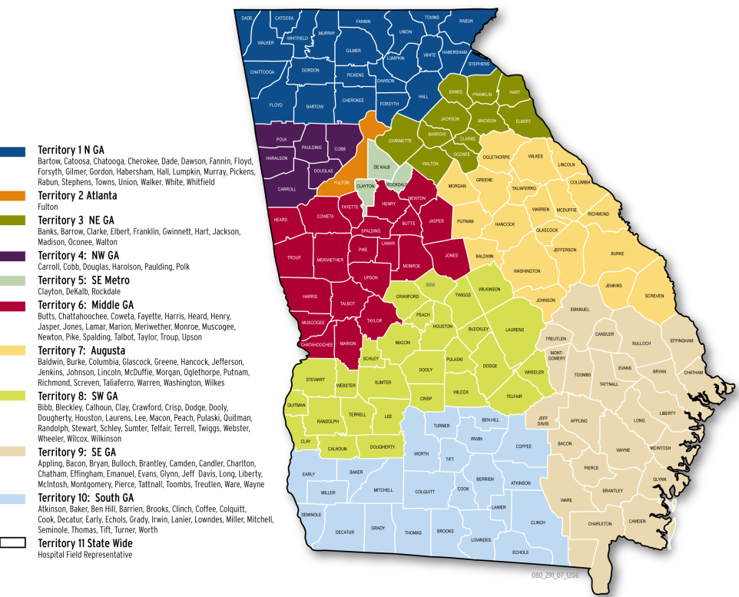
Georgia Field Territories

Slide 16
Provider Relations Field Services Representatives
State-Wide Consultants
Charlotte Couch
Sharée C. Daniels
Brenda Hulette

Slide 17
Policy Information (continued)
For additional questions concerning policy, contact DXC Technology’s Provider Services Contact Center (PSCC) at 800-766-4456.
The PSCC and the DXC Provider Relations Team can also be reached by initiating a “Contact
Us” inquiry on the GAMMIS website.

Slide 18
IVRS Overview
1-800-766-4456
Option 1 | Member Eligibility
Option 2 | Claims Status
Option 3 | Payment Information
Option 4 | Provider Enrollment
Option 5 | Prior Authorization
Option 6 | GAMMIS password reset, Pharmacy Benefits, the Nurse Aide Registry or Nurse Aide Training program, PeachCare for Kids,® EDI submission or electronic claim submission, or a system overview

Slide 19
Georgia Medicaid Spring Fair Tuesday, May 2, 2017 Cobb Energy Centre 2800 Cobb Galleria Parkway, Atlanta, GA 30339
Over 16 Breakout Sessions.
Banner Message and Invitation posted on GAMMIS with registration details.
Register now, it’s free!

Slide 20
Closing, Questions and Answers

